Slide 1
Architecture
and Urban Design
Fundamentals
B.S. Architectural Engineering 1984 (U. Texas, Austin)
M.Eng. Engineering Science 1992 (Penn State)
Ph.D. Electrical & Computer Engineering 1994 (U. Delaware)
Plus 2 years (39 credits) of Urban and Environmental Design (U. California, San Diego)
Ten years of Architectural experience in Texas, California, and Pennsylvania

Slide 2
Architectural Vocabulary
Form
Scale
Behavior
Context
Proportion
Balance
Symbolism
Tastes
Anthropomorphism
Color
Texture
Rhythm

Slide 3
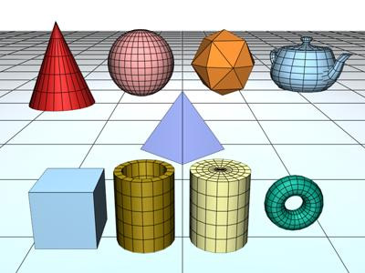
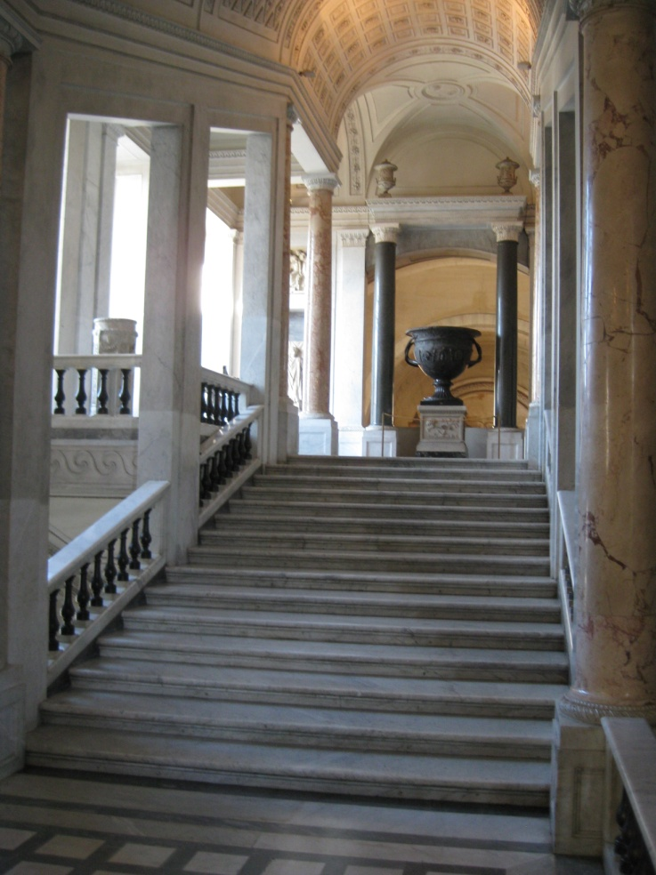
Form
Recently in the U.S. and many developing countries we accept geometric shapes with sharp edges
In the past, Euclidian (columns, domes) were more accepted
Frank Lloyd Wright said
“Form follows function.”
He later clarified this:
  “ Form follows function - that has been misunderstood. Form and function should be one, joined in a spiritual union.”

Slide 4
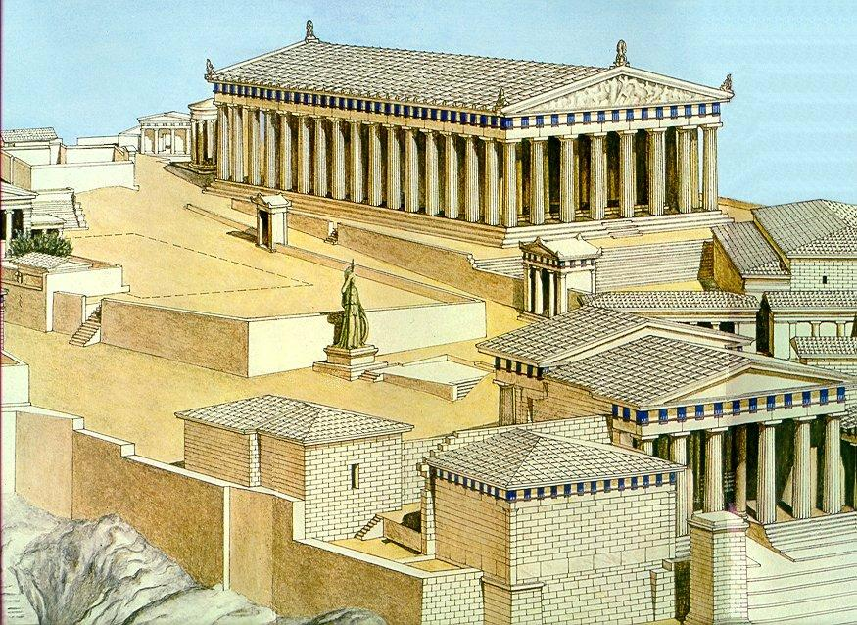
Scale
Architecture may relate to the scale of humans
  If not, architecture may be
    Monumental, impressive
    Intimidating, frightening
  Columns on building can give illusion of scale
  Surroundings and adjacent buildings can scale-up or scale-down a building

Slide 5
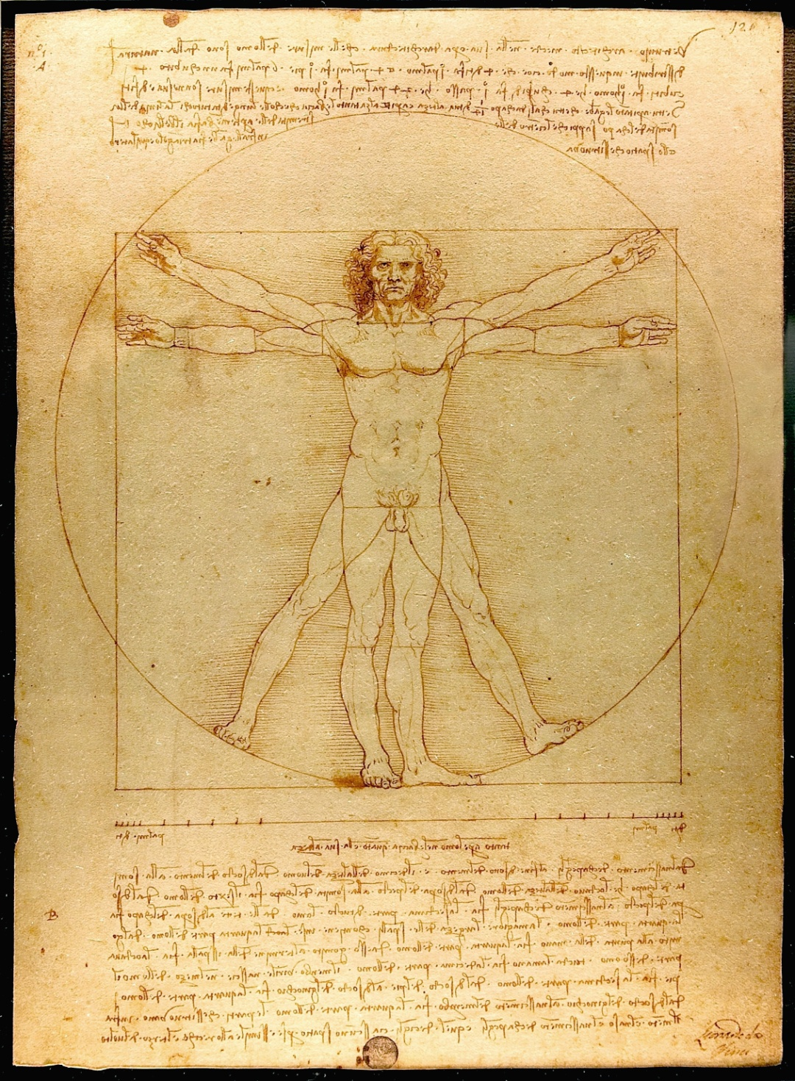
Behavior
Bodies create space
  Activities
    Ergonomics
  Group interactions
  Beliefs
  Movement through spaces
  Flow - interior to exterior
    Bank of widows and French doors invite outside in

Slide 6
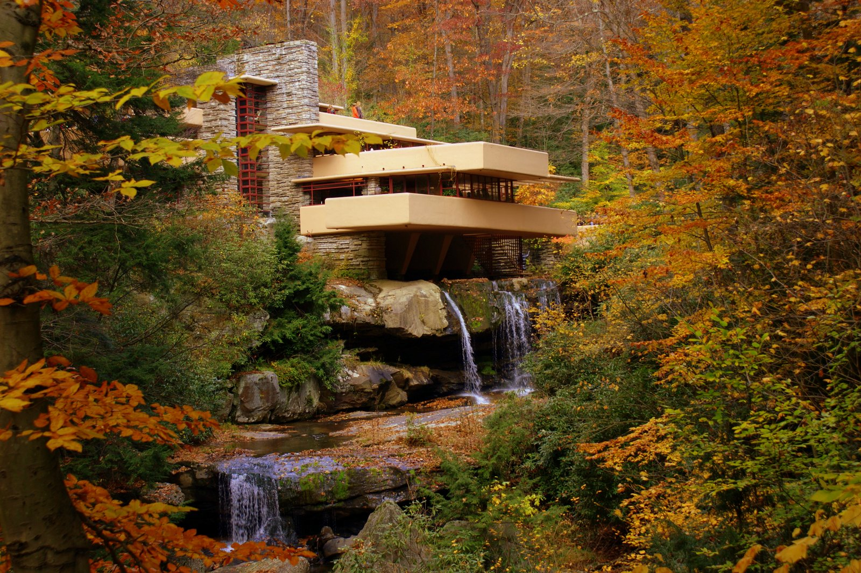
Context
Architecture can be an expression of a time
Can relate to other buildings
Can relate to land

Slide 8
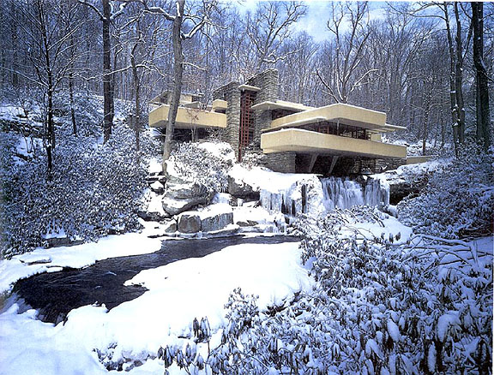

Slide 9
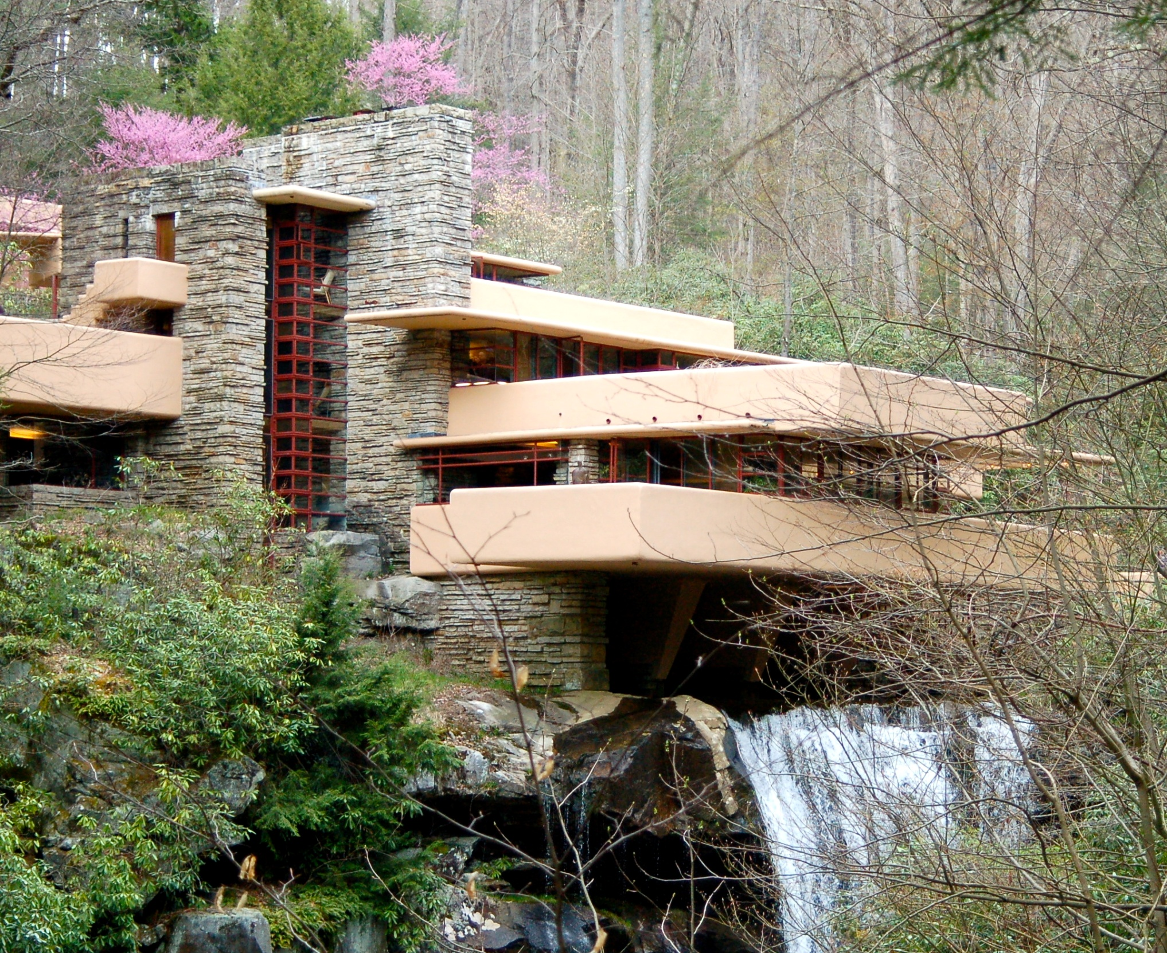

Slide 10
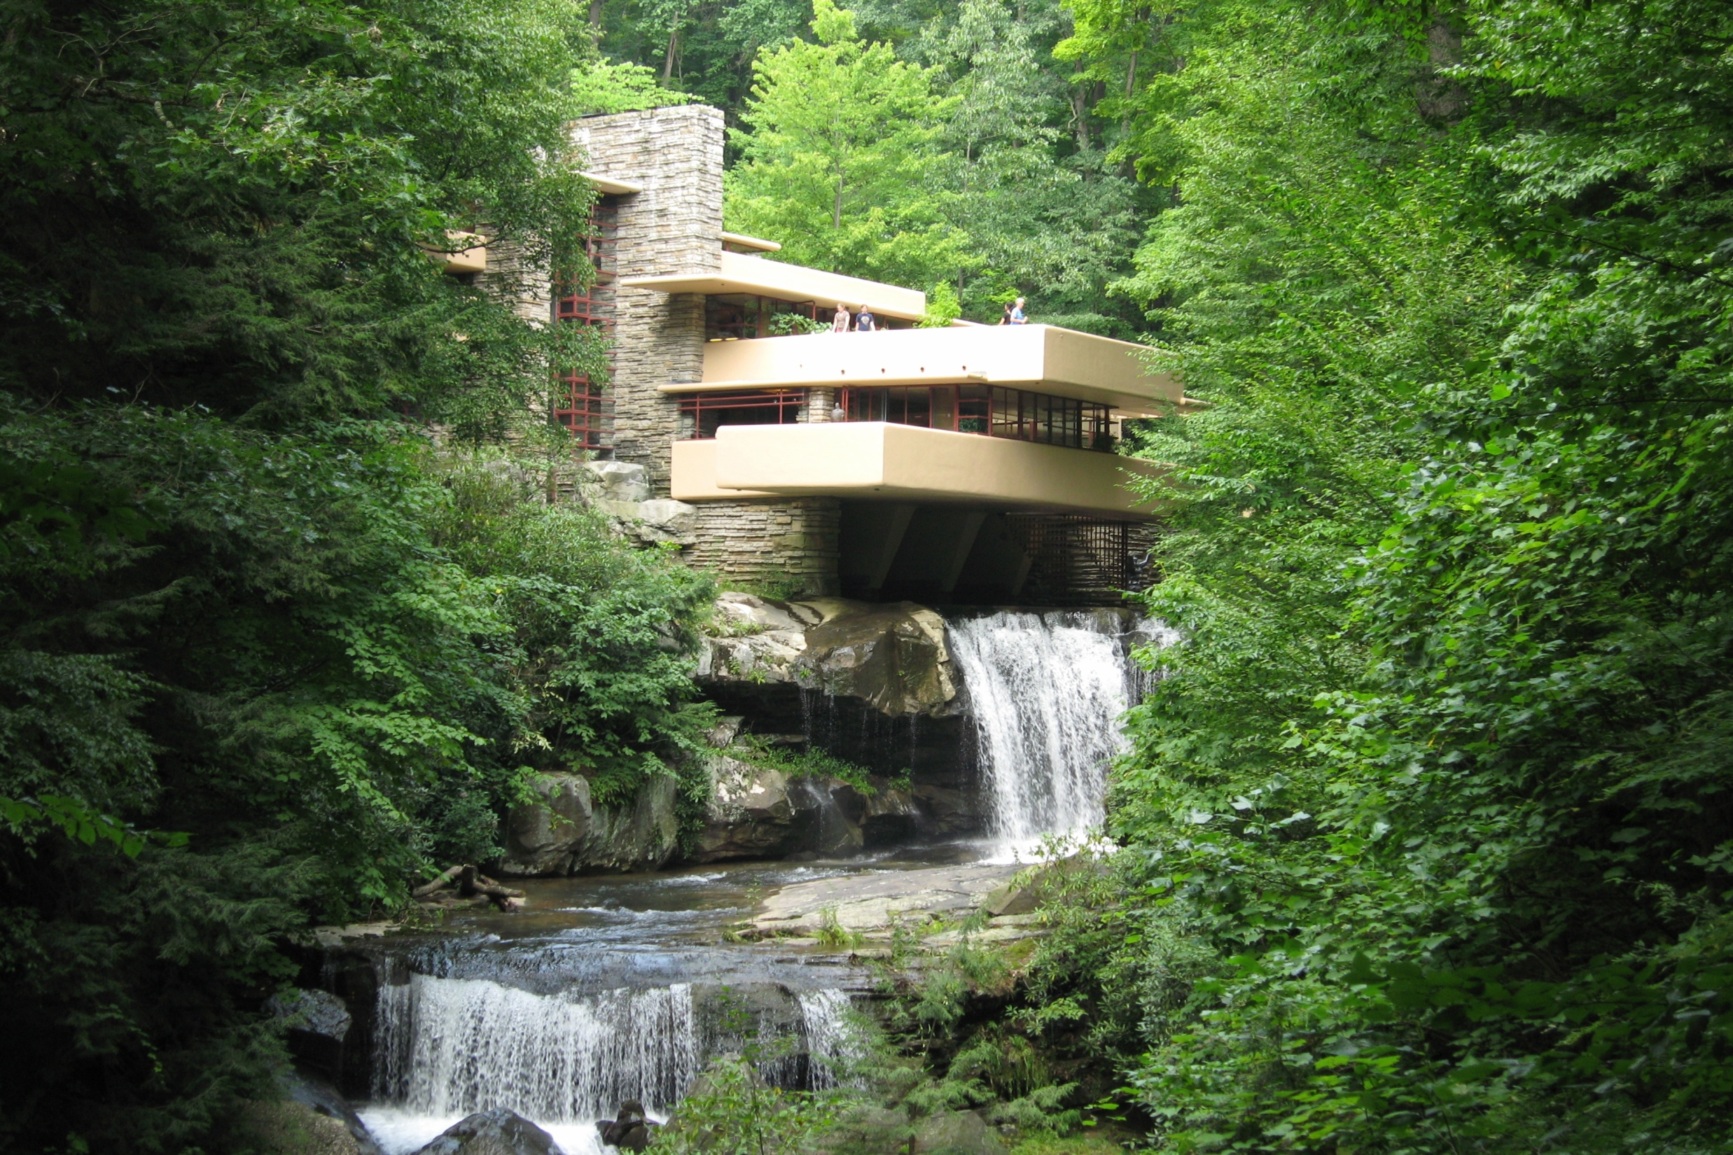

Slide 11
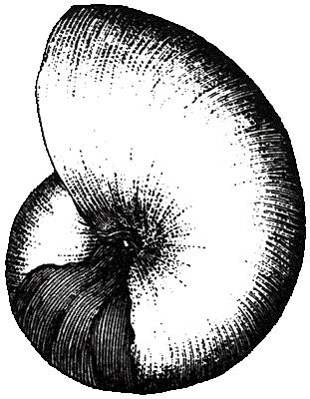
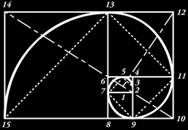
Proportion
Relation between spaces
  Between rooms in a floor plan
  Between elements of a facade

Slide 12
Balance
Symmetry
  May symbolize order, or wealth
  May put people at ease (perceived stable)
Asymmetry
  Can symbolize revolt
  Can evoke feeling of movement & excitement, or comfort
  Can arise from organic vernacular growth
    Medieval cities
  Frank Lloyd Wright made entrances low and dark to surprise with final destination.
  Also, light at end of corridor draws you in.

Slide 13
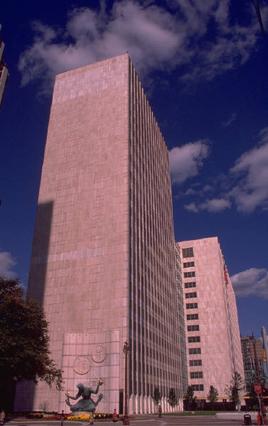
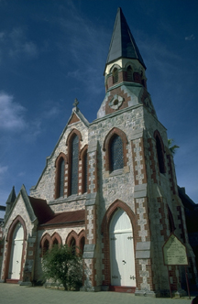
Symbolism
Power
Status
Change
Tradition
Spirit

Slide 14
Tastes
Change over time
Vary across cultures

Slide 15
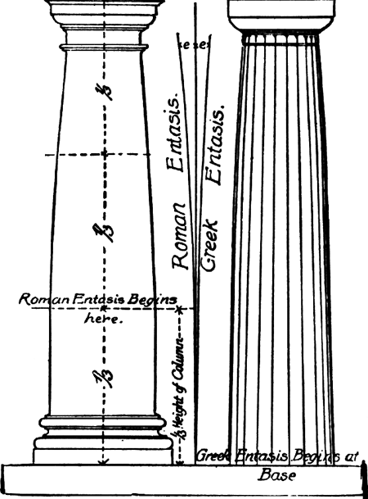
Anthropomorphism
Animate the inanimate
  Equate columns with humans
    “Entasis” in columns is a slight curvature to resemble hips

Slide 16
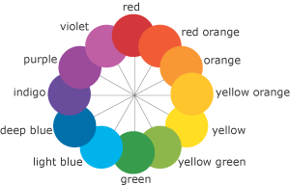
Color
Harmonized colors
  Use different hues of same color
  or pair hues of colors close to
  each other on color wheel

Slide 17
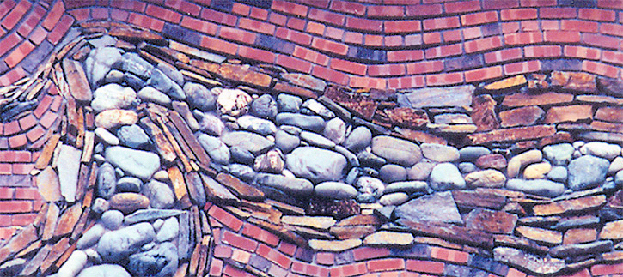
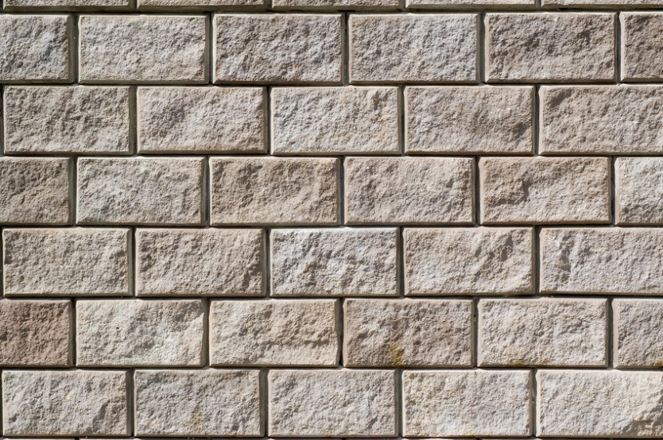
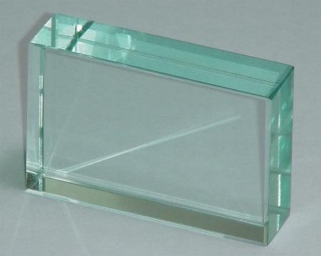
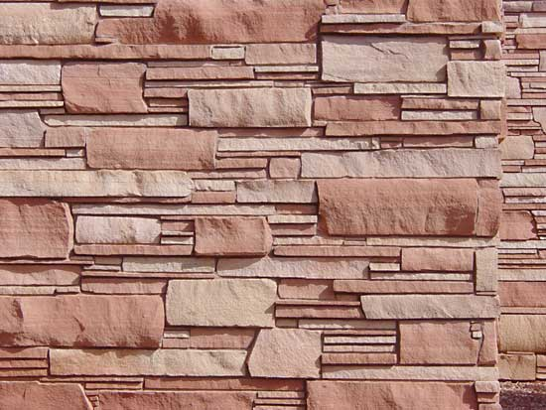
Texture
Random Ordered
Smooth Rough

Slide 18
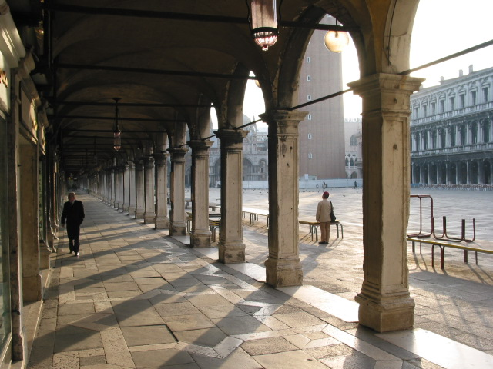
Rhythm
Like Music

Slide 19
Rhythm

Slide 20
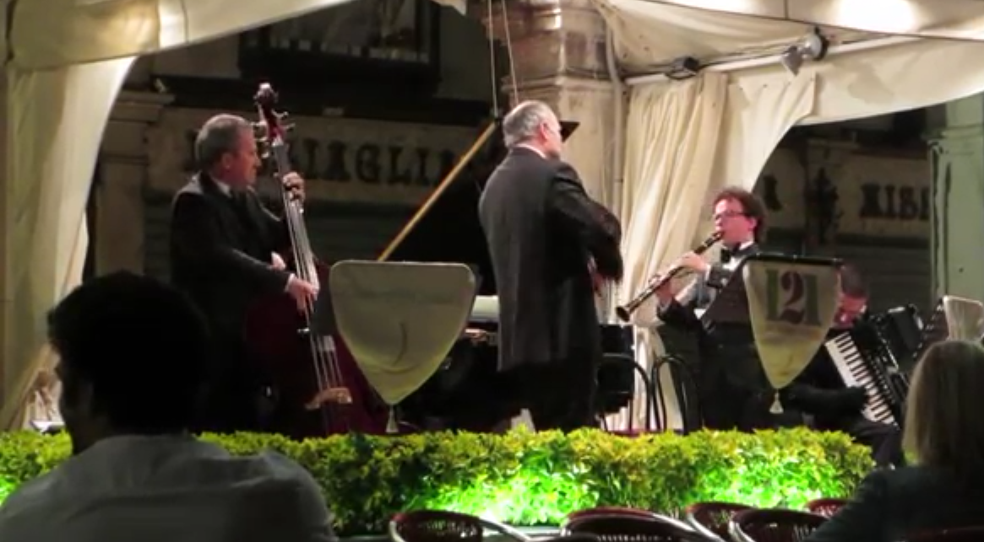
Rhythm
VIDEO: https://www.youtube.com/watch?v=36Fmp2pVKOc
Piazza San Marco, Venice Italy
Visited by JT Wunderlich three times

Slide 21
Architectural STYLES
Described using our architectural vocabulary

Slide 22
URBAN DESIGN
  “Urban Planning”
  “City Planning”
  “Urban Studies”
  “Environmental Design”

Slide 23
URBAN DESIGN
Five elements of “Lynch Analysis” (Kevin Lynch)
  PATHS: Streets, sidewalks, trails, and other
  channels in which people travel
  EDGES: Boundaries such as walls and shorelines
  DISTRICTS: Areas distinguished by some identity or
  character
  NODES: Focal points, intersections
  LANDMARKS: Easily identifiable objects which serve
  as external reference points

Slide 24
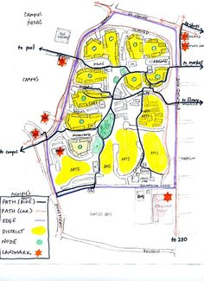
URBAN DESIGN
  PATHS
  EDGES
  DISTRICTS
  NODES
  LANDMARKS
SOURCE (Urban Design Graphics): https://www.pinterest.com/blockers99/urban-design-graphics/

Slide 25
URBAN DESIGN
Readings
  Lynch, Kevin (1960). The Image of the City. Cambridge MA: MIT Press.
  Wunderlich, Joseph T. (1987). The Evolution of City Boundaries. UCSD USP173 course paper.
  Wunderlich, Joseph T. (2015). Lynch analysis of Kyoto, Osaka, and Narita, Japan. Elizabethtown College lecture notes. (PPT)

