Slide 1
Elizabethtown College Architecture of Wellness and Sustainability
Joseph T Wunderlich PhD
Design & Technology-Transfer Studio Director
Associate Professor and Associate Chair of Engineering Program Coordinator for Computer Engineering Major and Architectural Studies Minor

Slide 2
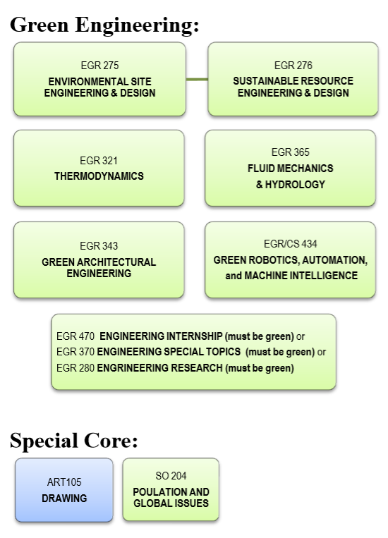
Sustainable Design
option for BS Engineering
Elizabethtown College, PA

Slide 3
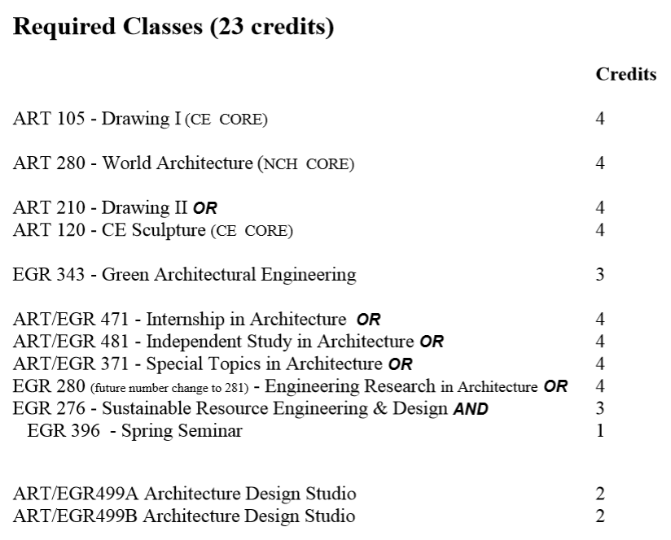
Architectural Studies Minor, Elizabethtown College, PA
JT Wunderlich 2015 Professor

Slide 4
Elizabethtown College Sustainability Committee
http://users.etown.edu/w/wunderjt/Sustainability_Committee_Academics_Report_version_1_5.pdf
JT Wunderlich 2015 Professor

Slide 5
A. SUSTAINABILITY-RELATED COURSES
A.1 Art
ART 280 - World Architecture
ART 471 - Internship in Architecture
ART 499A&B - Architectural Design Studios I & II
A.2 Biology/Environmental Science (Environmental science courses are within BIO prefix)
BIO 103 - Living with the Environment
BIO/EN 170 - Ecology in Short Fiction
BIO 112 - Principles of Evolution, Ecology and Diversity of Life
BIO 225 - Geographic Information Systems
BIO 235 - General Microbiology
BIO 313 - General Ecology
BIO 317 - Aquatic Ecology
BIO 318 - Marine Biology
BIO 320 - Conservation Biology
BIO 335 - Microbial Ecology
BIO 362 - Ecotoxicology
A.3 Business
BA 265 - Principles of Management (required for all business majors)
BA 372 - Sustainable Marketing (elective)
A.4 Communications
COM 485 - Senior Seminar (two Etown Sustainability videos produced to-date)
A.5 Economics
EC 102 - Principles of Microeconomics (required for all business majors)
EC 370 - Environmental Economics (elective)
A.6 Education
ED 325 - Methods for teaching Science and Health in Early Childhood
ED 326 - Methods for teaching Science and Health in Elementary/Middle Level

Slide 6
A.7 Engineering SUSTAINABILITY-RELATED COURSES
EGR 275 - Environmental Site Engineering & Design
EGR 276 - Sustainable Resource Engineering & Design
EGR 280 - Engineering Research in Sustainable Design
EGR 280 - Engineering Research in Architecture
EGR 321 - Thermodynamics
EGR 365 - Fluid Mechanics and Hydrology
EGR 370 - Introduction to Environmental Engineering
EGR380 - Water & Wastewater Design
EGR 343 - Green Architectural Engineering
EGR 434 - Green Robotics, Automation, and Machine Intelligence
EGR 471 - Internship in Architecture
EGR 491/492 - Senior Design Project
EGR 499A&B - Architectural Design Studios I & II
A.8 Earth Science
ES 113 - NPS Earth in Space: Evolution of a Planet
ES 114 - NPS Geosystems: Landscapes, Oceans and Atmosphere
ES 117 - NPS Climate Change and the Fate of Civilization
ES 216 - Physical Geography
A..8 History
HI 208 - Technology and Values in American Experience
A.9 Philosophy
PH 255D - Advanced Ethics: Environmental
A.10 Peace and Conflict Studies
A.11 Political Science
PS 361 – Public Administration
A.12 Religion
REL 151 - Life Meaning and Purposeful Work
REL 291 - Indic Religions: Hinduism, Jainism, and Sikhism
REL 292 - Buddhism
REL/SOC 364 - Amish Society
A.13 Sociology and Anthropology
SSC 204 - Population and Global Issues

Slide 7
SUSTAINABILITY-RELATED PROGRAMS
B.1 Architectural Studies Minor ( including integrated four-year plans for engineers)
B.2 Biology BS (environmentally-oriented students often choose Biology BS over Environmental Science BS)
B.3 Engineering BS- Sustainable Design Concentration
B.4 Engineering BS – Mechanical Engineering and Electrical Engineering Concentrations
B.5 Environmental Science BS - we need a multi-disciplinary environmental studies minor or major
B.6 Environmental Management Masters (with Duke) No student has yet participated
B.7 Forestry Management Masters (with Duke) No student has yet participated
B.8 General Science BS
B.9 Public Policy 5th year program (get BS or BA in any Major, then add year of Policy Making)
B.10 Religious Studies BA
B.11 Studio Art Minor
B.12 Theatre BA (set design)
SUSTAINABILITY-RELATED FACULTY EXPERTISE
Too many to list here

Slide 8
SUSTAINABILITY-RELATED SPACES
D.1 Art Studios
D.2 Architectural Computer Servers (virtual green architectures and towns)
D.3 Biology Environmental Science Labs
D.4 Campus (Lake, wetlands, much farmland across from quads,
organic garden – 300 pounds per year harvested, etc)
D.5 Education Department classrooms and labs
D.6 Engineering Environmental Engineering Research Lab
D.6 Engineering Fabrication Lab
D.7 Engineering Geosciences Lab/Studio
D.8 Engineering Design & Technology-Transfer Studio
D.9 Engineering Solar Cabin and Sustainability-electronics Lab
D.9. Math Computer lab (E368).
- Has ArcGis geographic information system (GIS) software
D.10 Political Science spaces
D.11 Religious Studies – Young Center
D.12 Sociology and Anthropology spaces
OFF-CAMPUS: We have use of Lancaster County Conservancy preserves for
research & student projects. Closest one 3 miles away

Slide 9
E. SUSTAINABILITY-RELATED SCHOLARSHIP
E.1 Faculty research and publications (List to be compiled)
E.2 “Sustainability-Related Grant Applications and Awards”
- List removed for confidentiality
E.3 Scholarship & Creative Arts Day Sustainability Symposiums
(including our 4th annual event March 21, 2015)
E.4 “GreenCon” Regional conferences
F. SUSTAINABILITY-RELATED CLUBS
F.1 “Biking Club”
F.2 “Environmental Group”
– M. Kozimor-King, Sociology
- Susan Webster, English
F.3 “FEAST” (Future Energies and Sustainable Technologies)
– T. Estrada, Engineering
F.4 “Habitat for Humanity”
F.5 “National Science Teachers Association”
– K. Blouch, Education
F.6 “Outing Club”
F.7 Engineers Without Borders (EWB) student chapter being formed

Slide 10
G. ACADEMIC COMPETITIONS
and OPPORTUNITIES FOR STUDENTS TO PUBLISH
G.1 Engineering Solar Decathlon
- Partially planned for in Spring 2013 Charette
G.2 Engineering Solar Boats
- It’s been several years since competing
G.3 Engineering Intelligent Ground Vehicle Competition
- Includes environmental mapping
- We competed three times in this
- Several years since we competed
G.4 Mobile Wellness Center Design Competition (Spring 2014)
G.5 Campus Wellness Center Design Competition (Fall 2015) – 8 judges
G.6 Health-Clinic Designsfor Sierra Leone, Africa (Fall 2015) – 22 judges

Slide 11
H. ACADEMIC OUTREACH
H.1 Professional affiliations
- Sierra Club, USGBC, EPA, NSPE, AIA, ASCE, ASEE, IEEE, ASME, etc)
H.2 Local farms
- Methane Digester saves $15,000/yr
H.3 Masonic Homes
- Largest Masonic retirement facility in the Nation? – Next door to us
H.4 Collaborations with other U.S. Schools
- Universities, Colleges, High-schools, Grade-schools
H.5 Collaborations with Schools Abroad
- Univ of Trento in Italy, Pantheon Institute in Rome, U. Gambia in Africa
H.6 Corporate affiliations
- Phoenix Contact USA and Germany, IBM, SustainX, Bechtel, etc
H.7 Government
- DEP, Planning commissions, Building inspectors, Mayors, State
Legislature, U.S. Congress, Governor Tom Wolf, Senator Bob Casey
H.8 Foreign governments
- Italy, Gambia, Japan, Costa Rico, Middle East
H.9 Venture Capitol start-ups
- Via Ambassador Craig’s International venture capital company, etc
H.10 NGO’s
- Peace Core, Habitats for Humanity, World Vision, Lancaster County
Conservancy, etc
H.11 Young Center and churches
- Don Kraybill for Amish and Mennonites
- Jeff Long for Hinduism, Jainism, and Buddhism.
H.12 Native Americans

Slide 12
I. SUSTAINABILITY-RELATED INTERNSHIPS
I.1 USGBC
J. PRESS
J.1 Winter 2012 Elizabethtown College Magazine “Blue and gray turns green”
J.2 SLE-Capstone Architecture Poster to Trustees
- And again to “Trustees in Training” on March 20, 2015)
J.3 Talk at Franklin & Marshal for Greencon15, March 19, 2015 3:30p
“Elizabethtown College Architecture of Wellness and Sustainability”
J.4 Compare our Green web-presence to other schools (2014)
- Hopefully action taken in 2015
K. FACULTY/STAFF COLLABORATIONS
K.1 Successful 2013 Hydroponic Gardens
- Originally in Design & Technology-transfer Studio
- Now being built in food services
K.2 New large Elizabethtown College Photovoltaic Array to be built

Slide 13
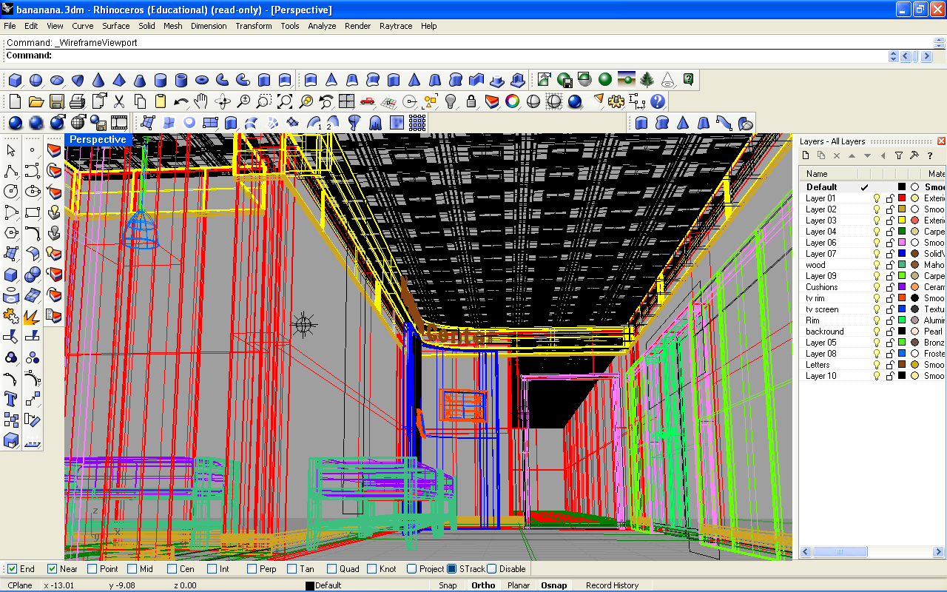
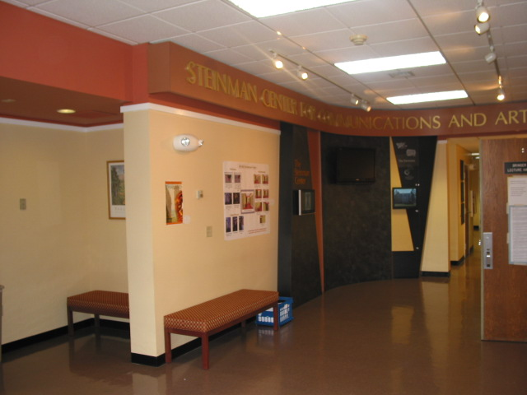
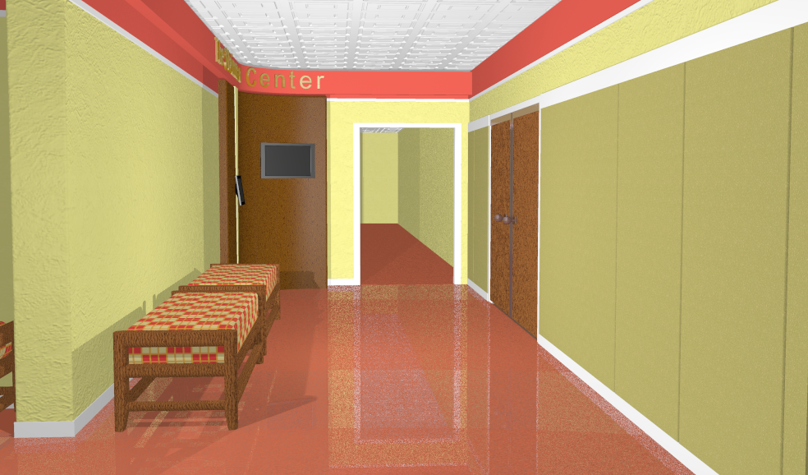
ETOWN Architecture 2006
Rhinoceros and Flamingo software

Slide 14
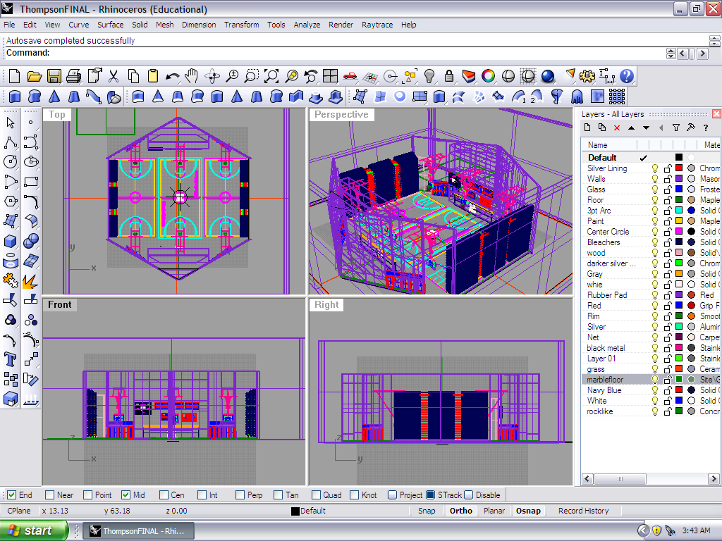
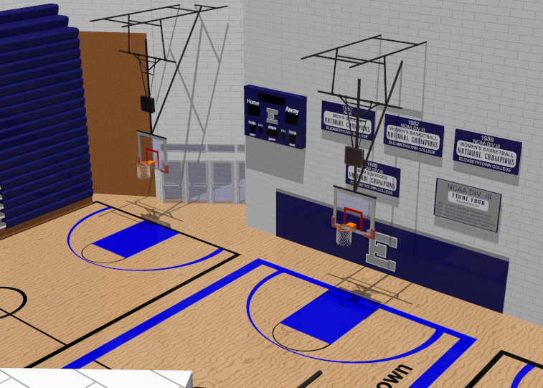
ETOWN Architecture 2006-2010
Rhinoceros and Flamingo software

Slide 15
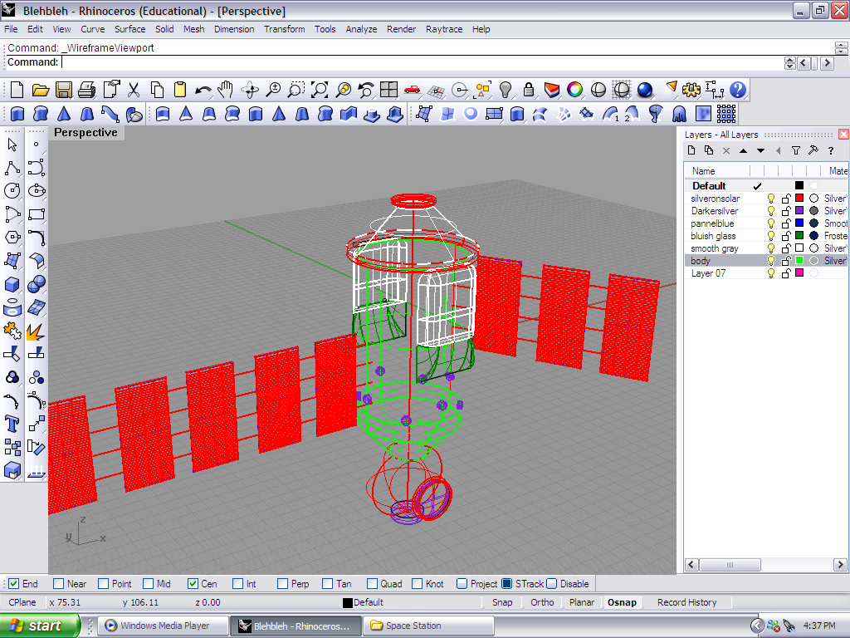
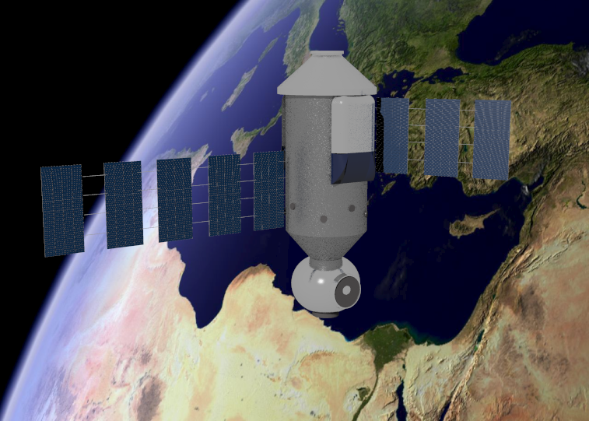
ETOWN Architecture 2006-2010
Rhinoceros and Flamingo software

Slide 16
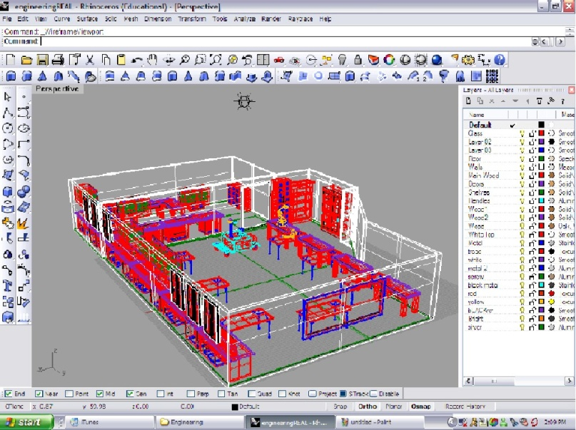
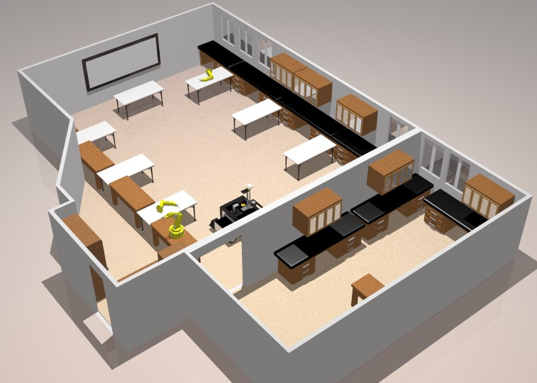
ETOWN Architecture 2006
Rhinoceros and Flamingo software

Slide 17
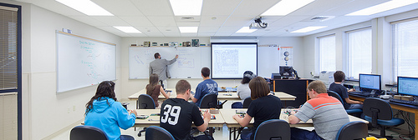
Design & Technology-Transfer Studio
( formerly “Robotics & Machine Intelligence Lab”)

Slide 18
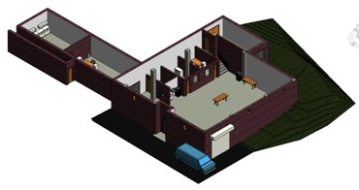
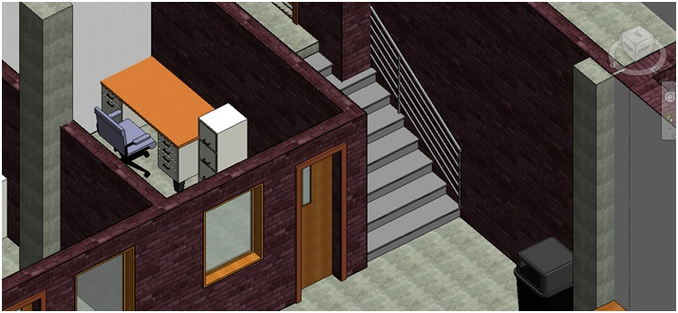
ETOWN Architecture 2012
Revit software

Slide 19
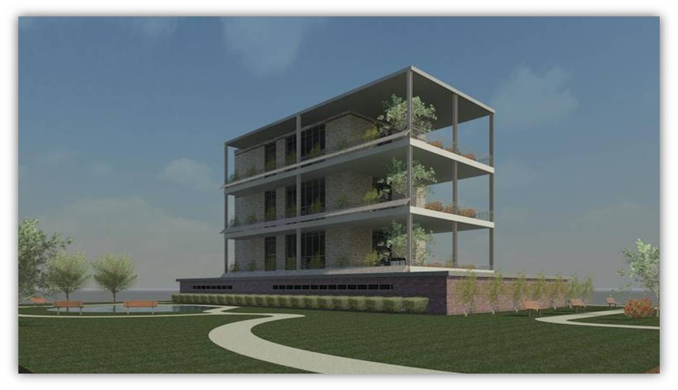
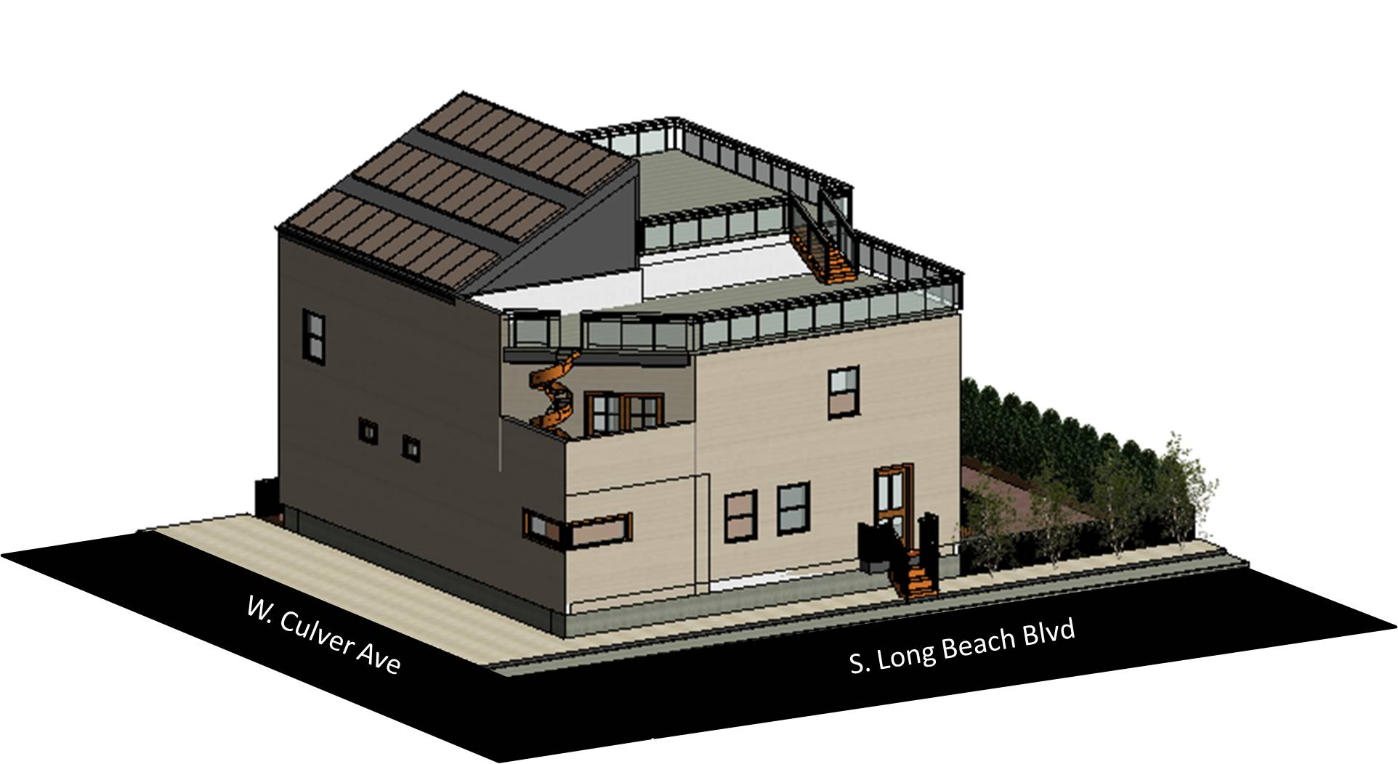
ETOWN Architecture 2012
Revit software

Slide 20
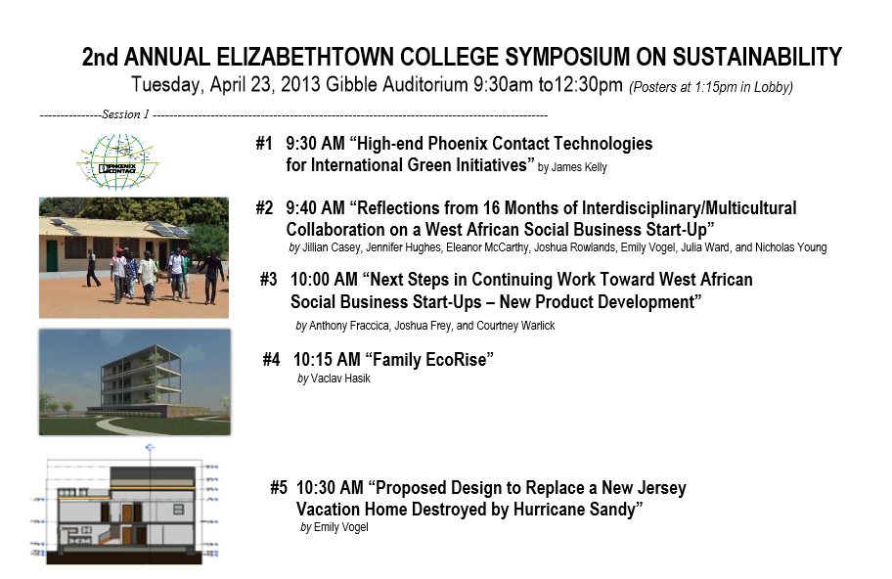
ETOWN Sustainability Symposiums 2012,13,14,15
Part of our Annual Scholarship And Creative Arts Day

Slide 21
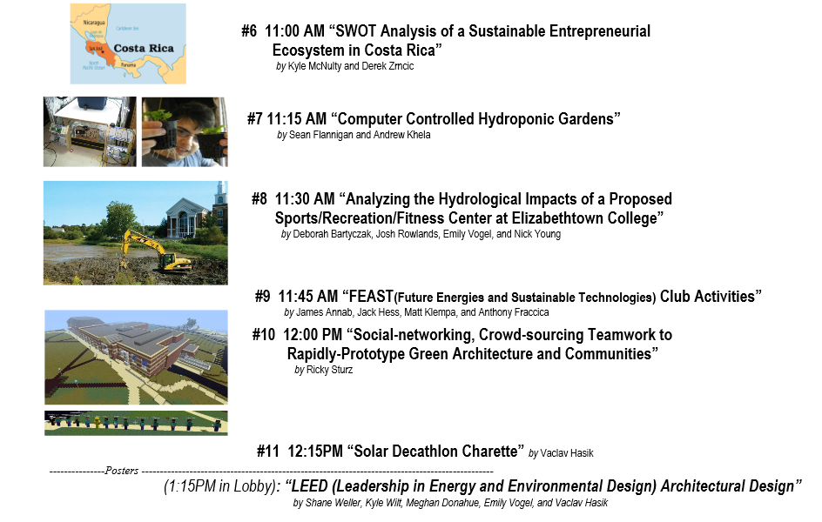
ETOWN Sustainability Symposiums 2012,13,14,15
Part of our Annual Scholarship And Creative Arts Day

Slide 22
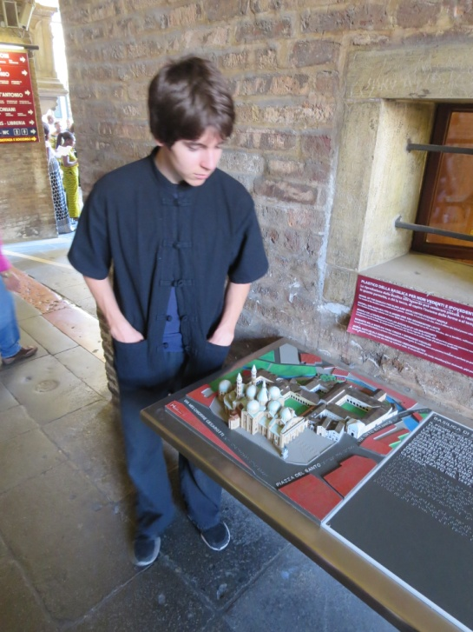
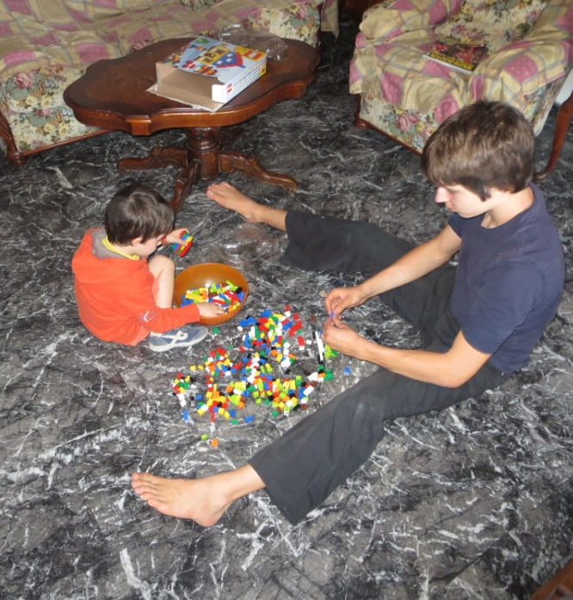
JT Wunderlich 2004, 2008, 2009, 2011, 2014 Professor Surveyed Italian Architecture in Italy (while presenting and teaching) Venice (three times) Padova (twice) Trento (twice) Roveretto Florence Tuscan county side Rome Genoa Porto fino Santa Magrietta

Slide 23
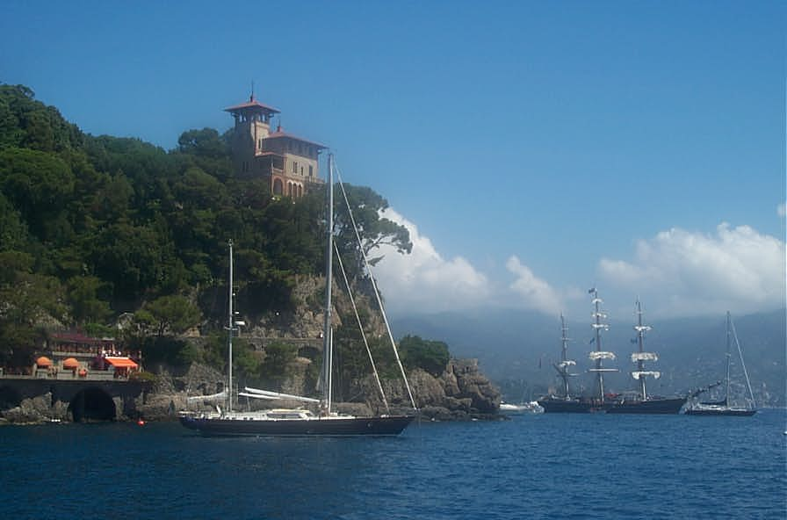
JT Wunderlich 2004, 2008, 2009, 2011, 2014 Professor

Slide 24
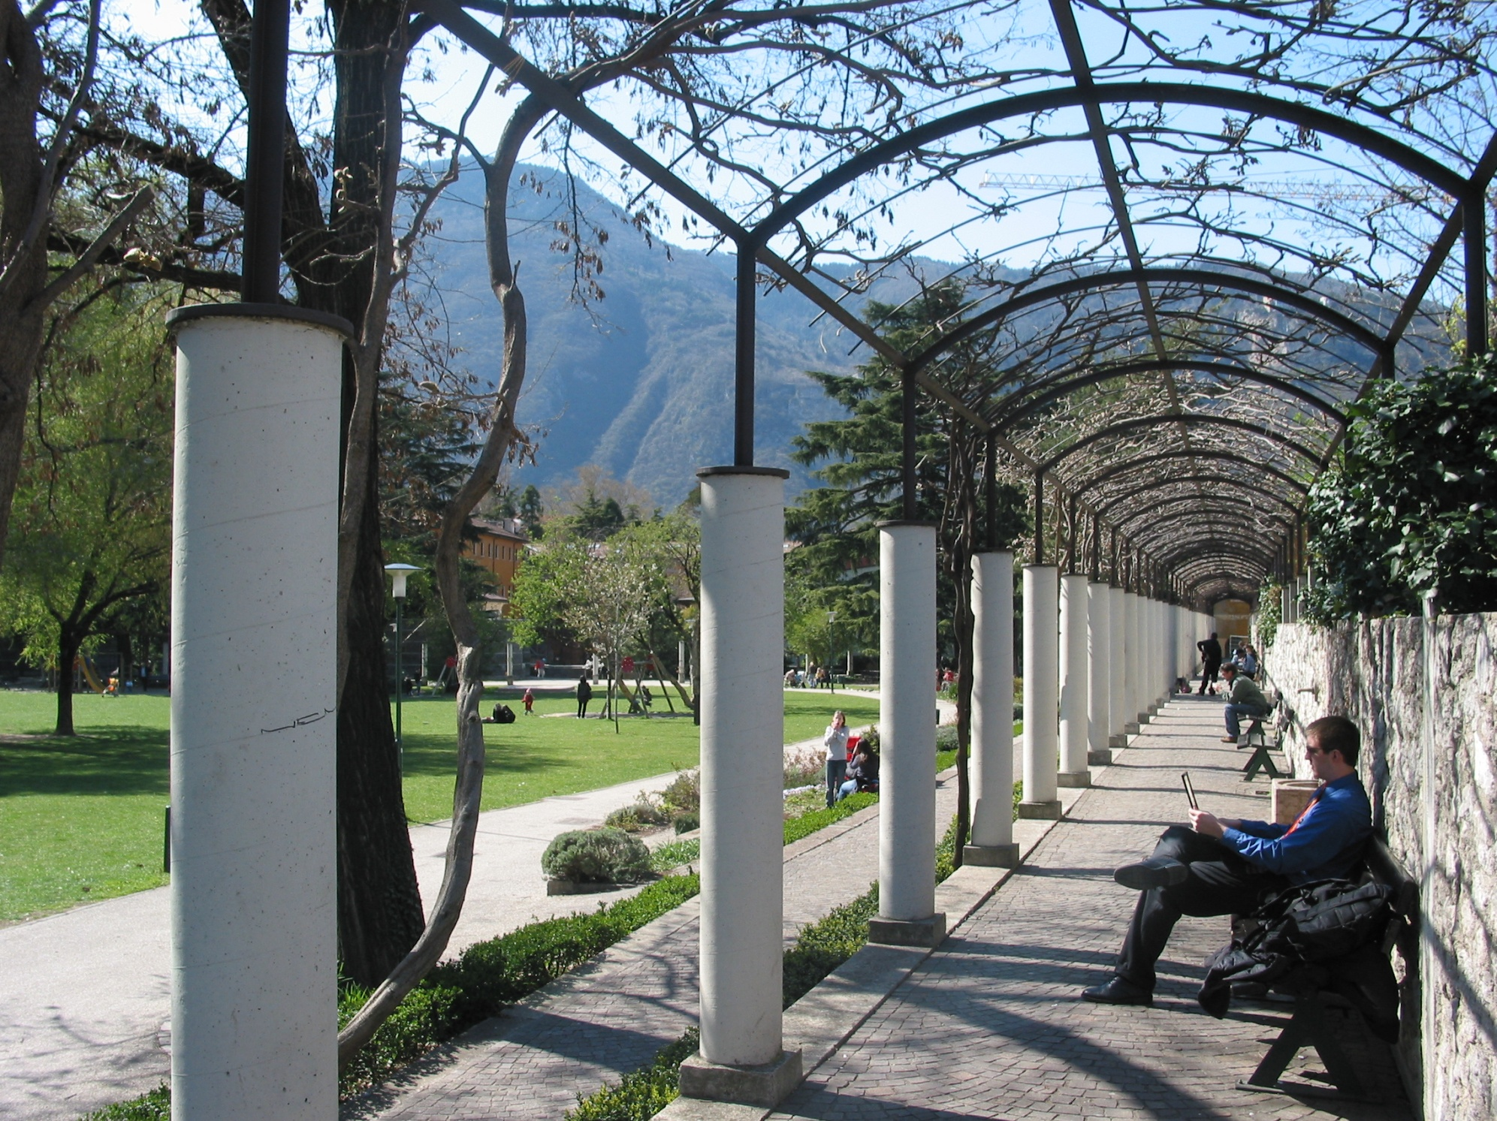
JT Wunderlich 2004, 2008, 2009, 2011, 2014 Professor

Slide 25
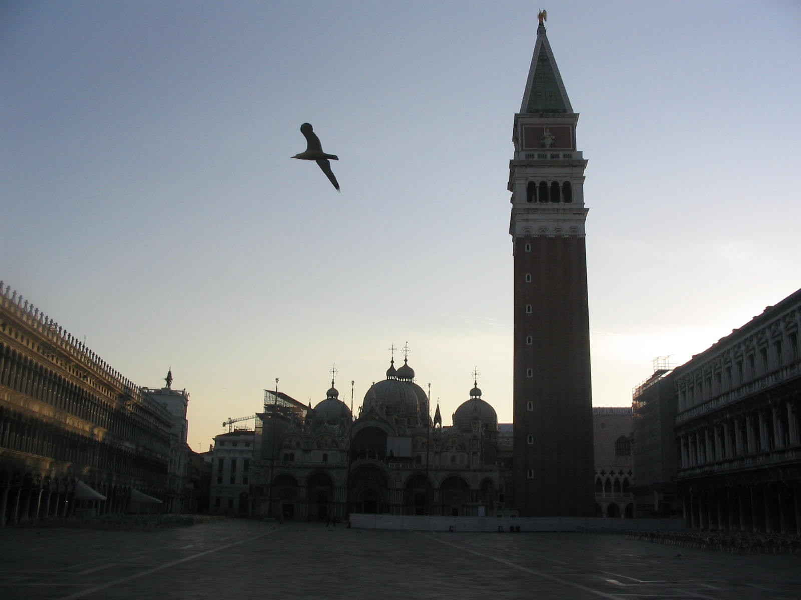
JT Wunderlich 2004, 2008, 2009, 2011, 2014 Professor

Slide 26

JT Wunderlich 2004, 2008, 2009, 2011, 2014 Professor

Slide 27
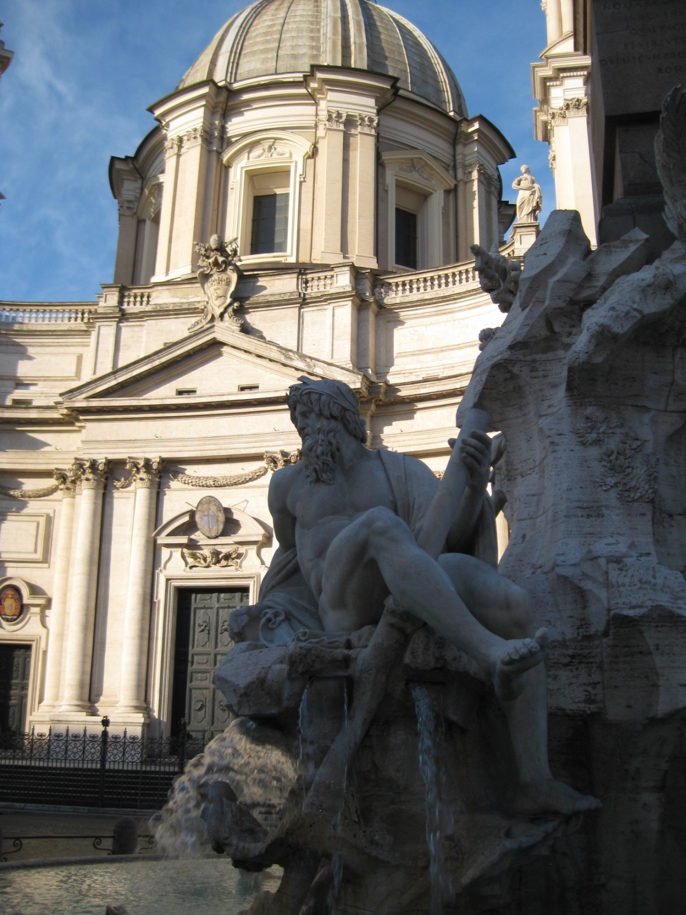
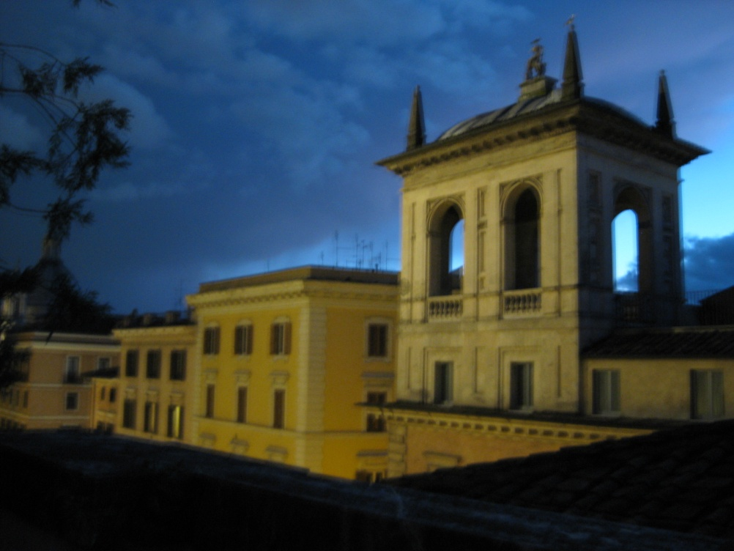
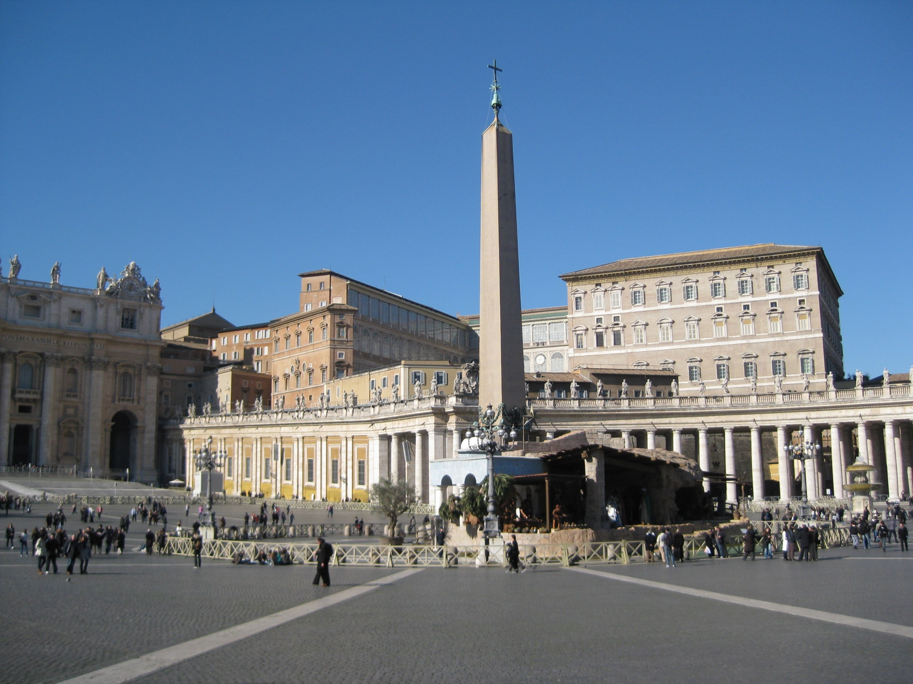
JT Wunderlich 2004, 2008, 2009, 2011, 2014 Professor

Slide 28
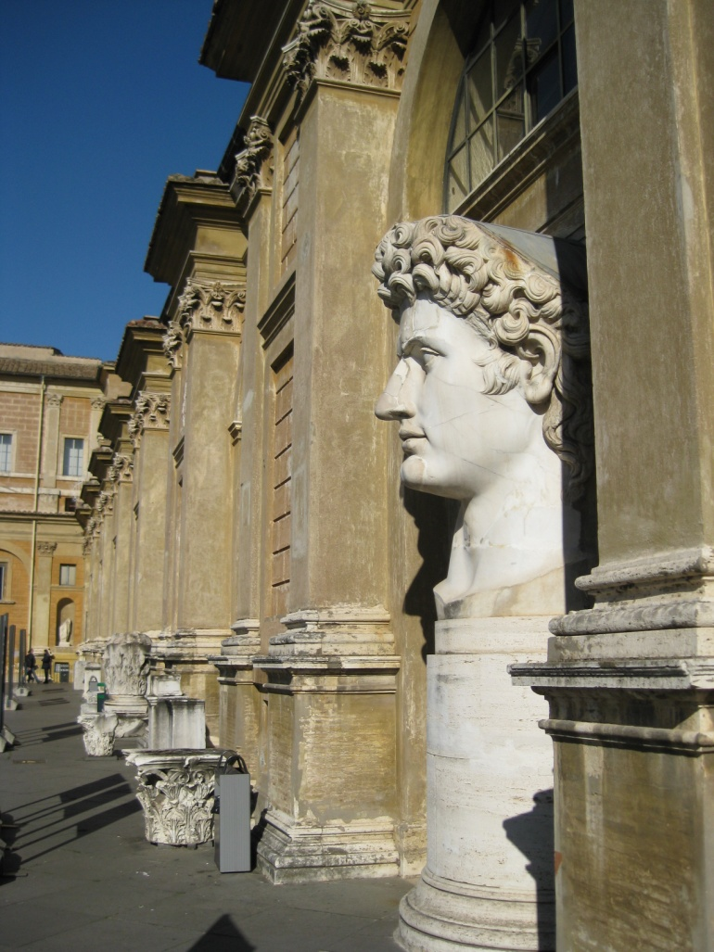
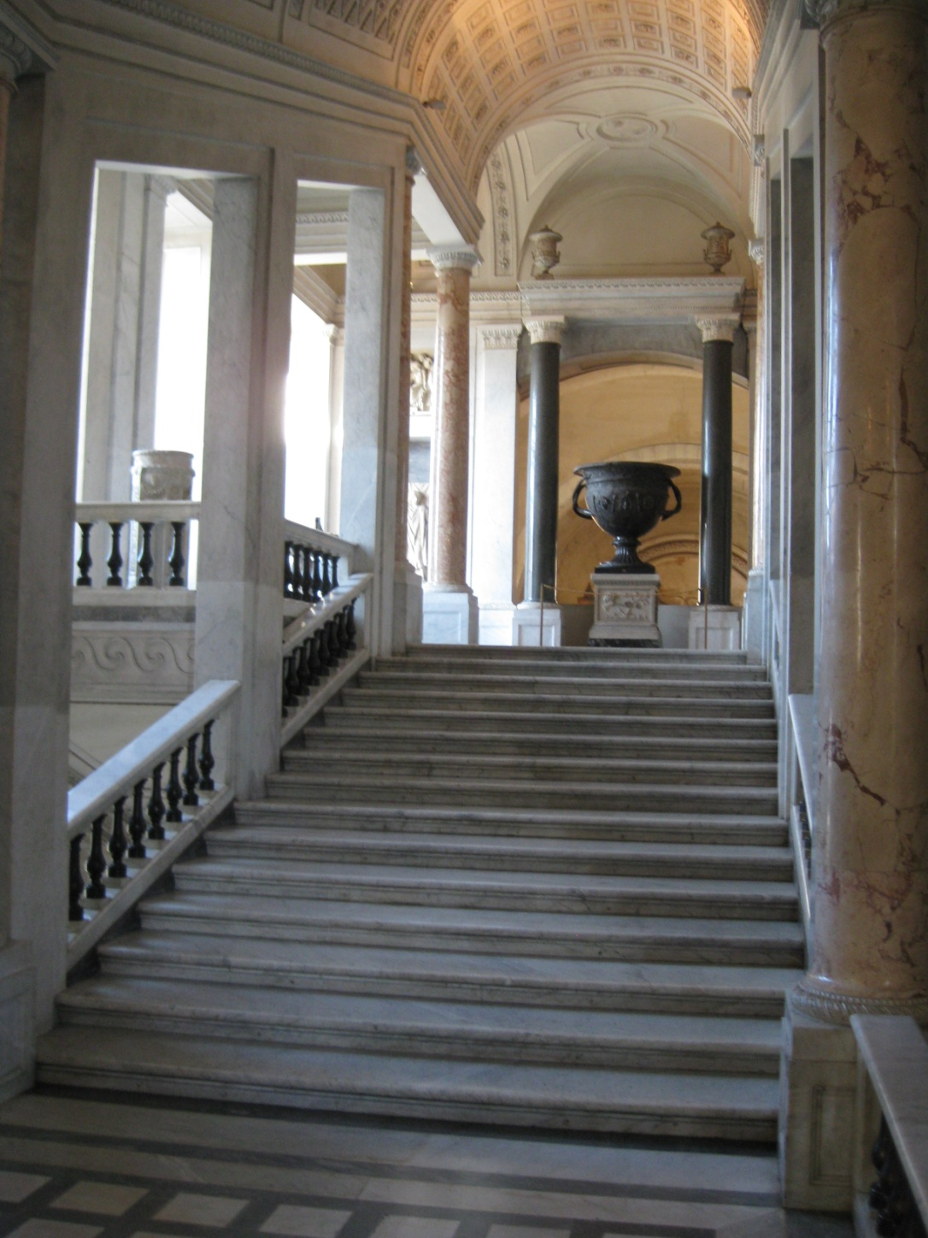
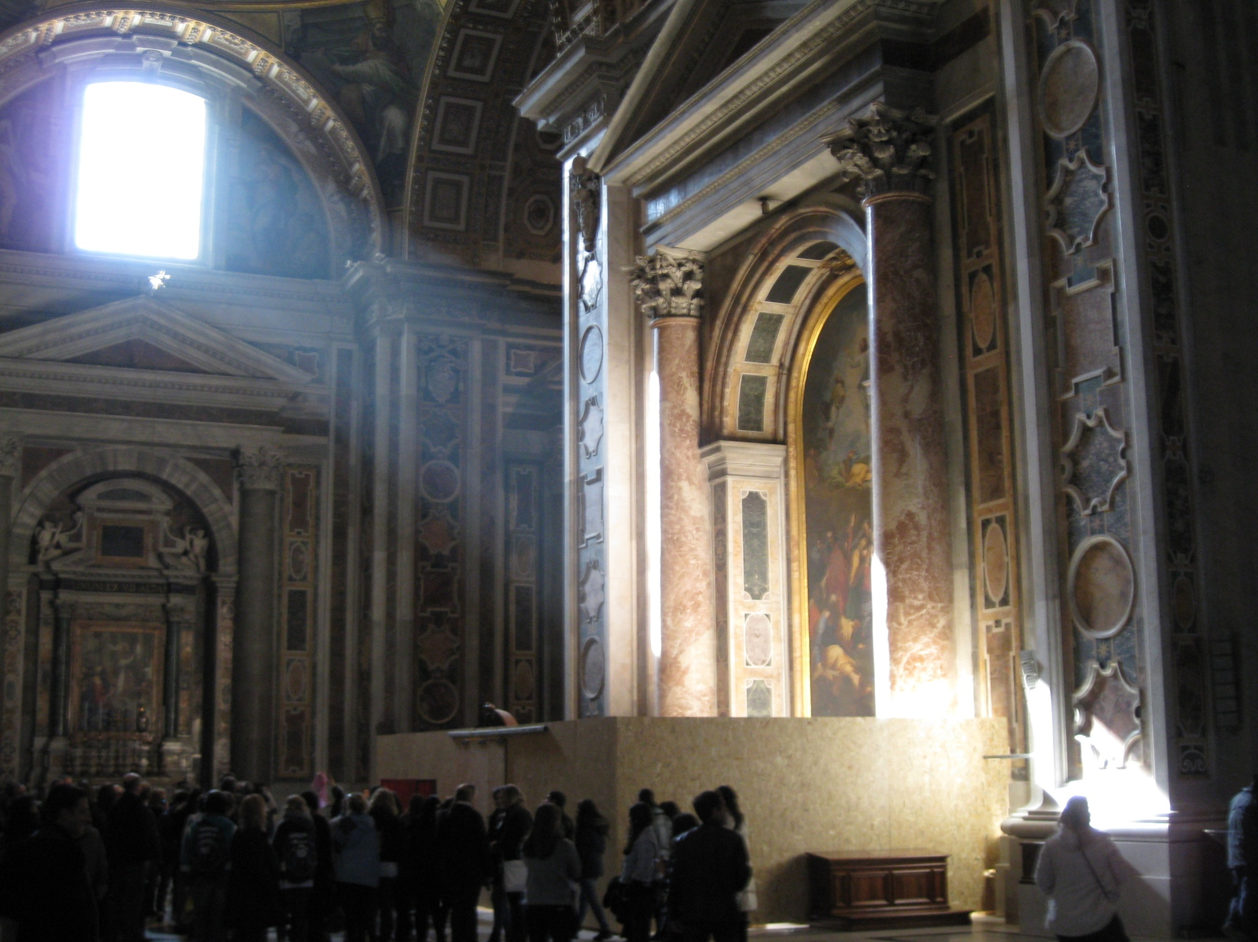
JT Wunderlich 2004, 2008, 2009, 2011, 2014

Slide 29
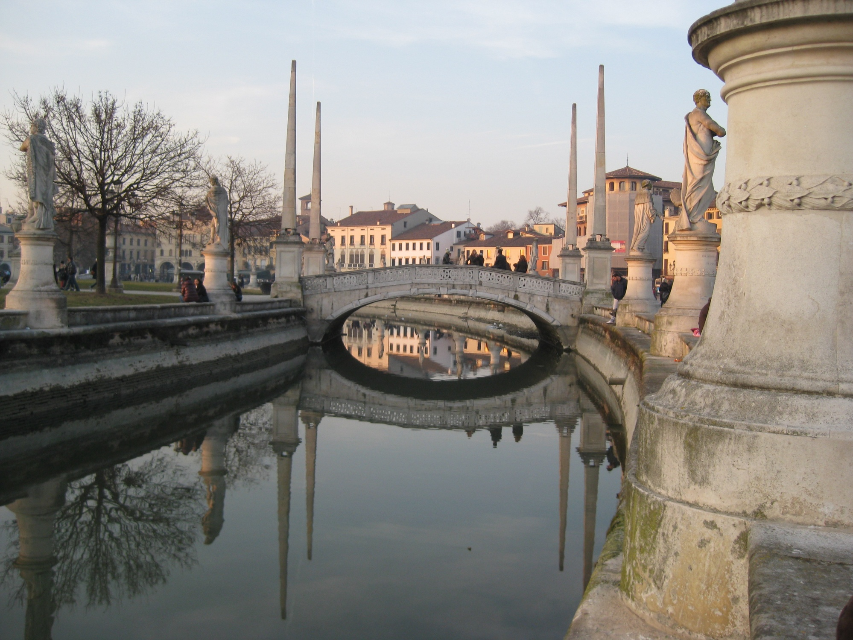
JT Wunderlich 2004, 2008, 2009, 2011, 2014

Slide 30
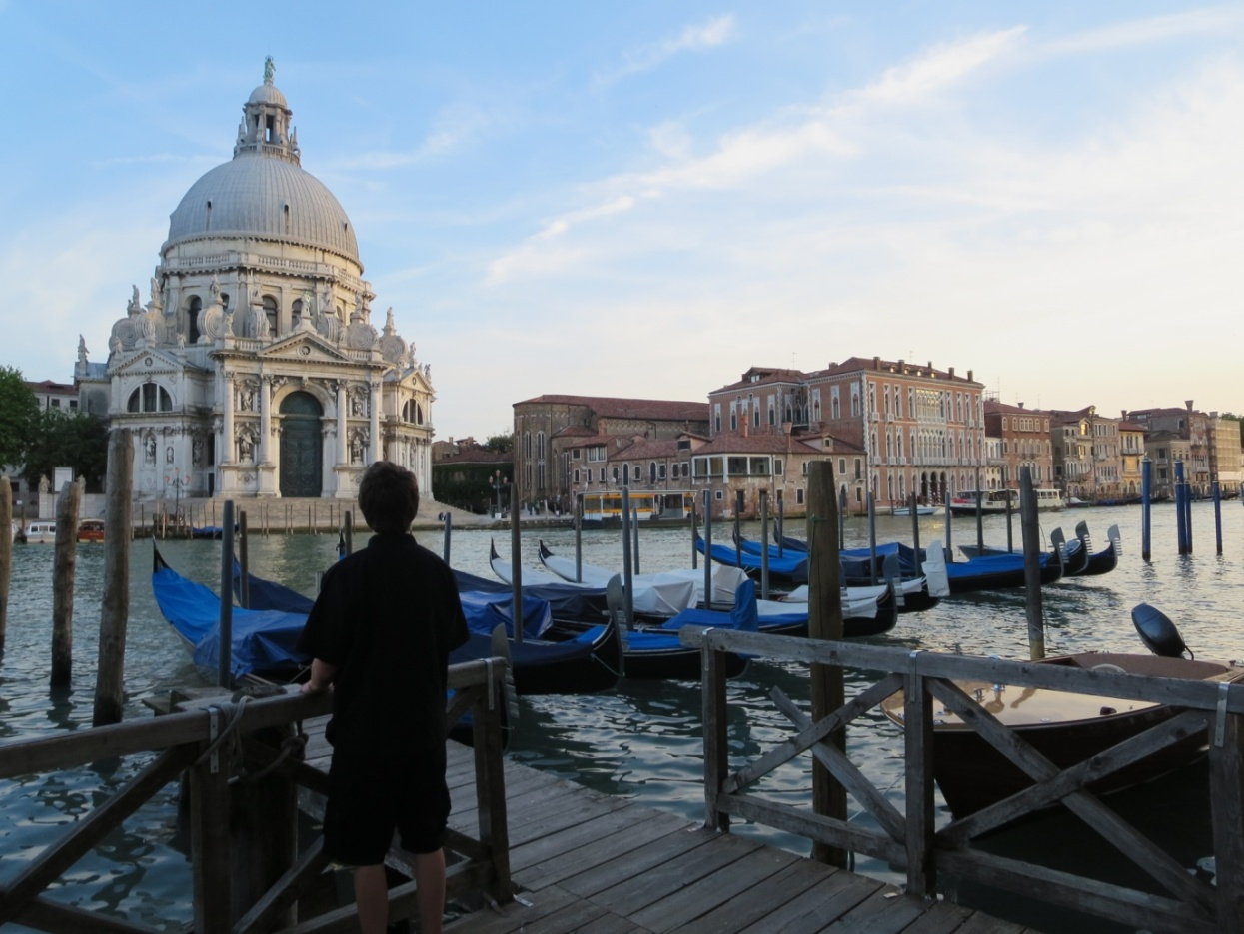
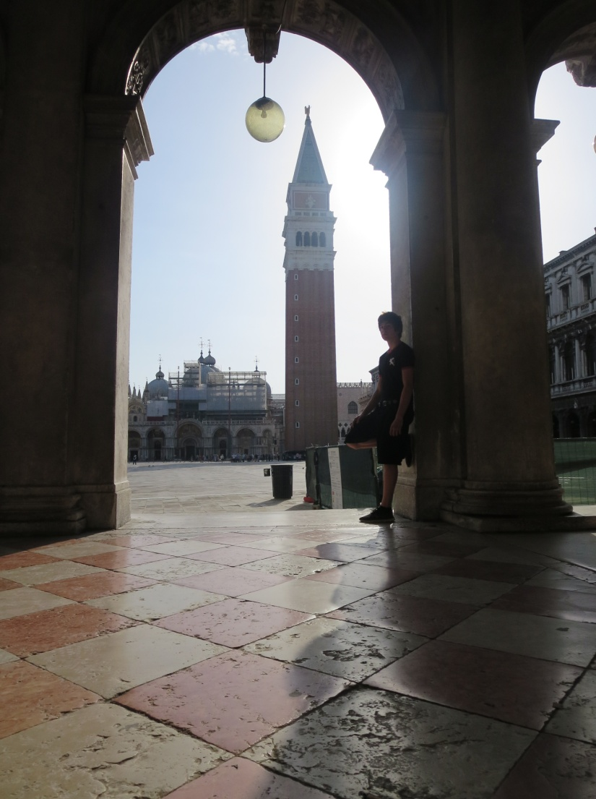
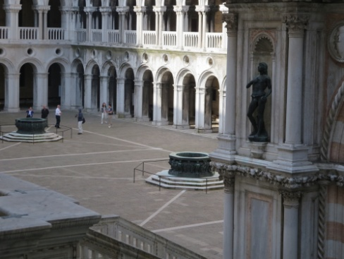
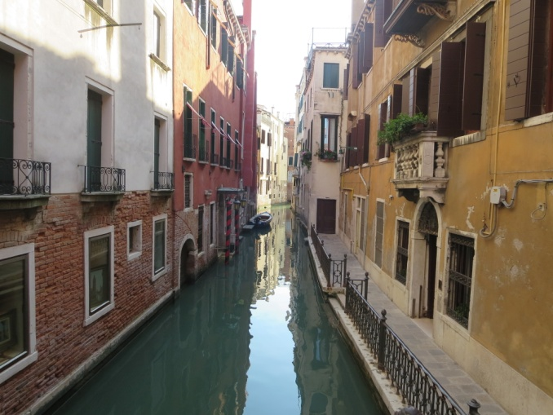
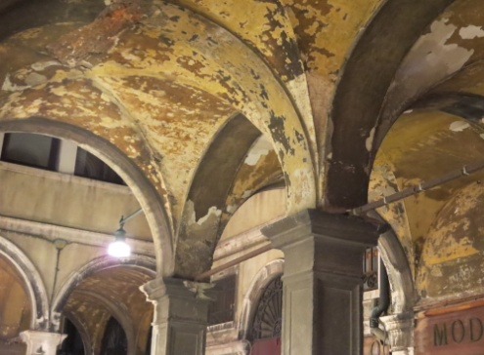
JT Wunderlich 2004, 2008, 2009, 2011, 2014 Professor

Slide 31
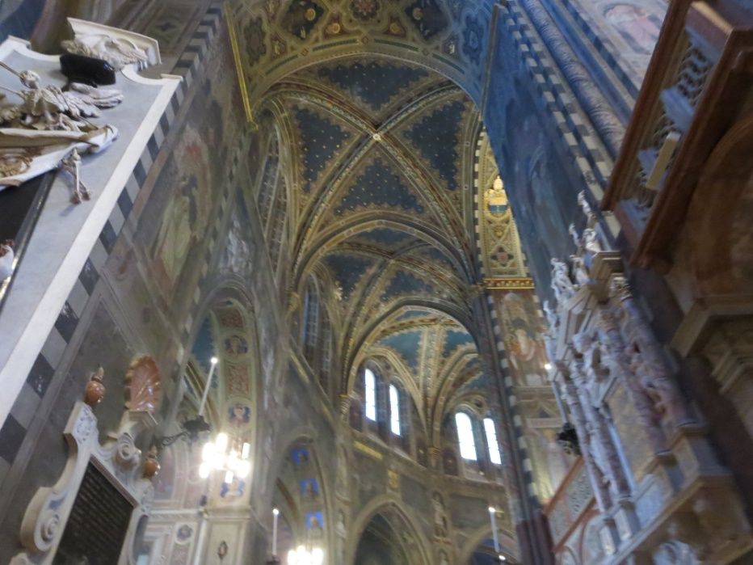
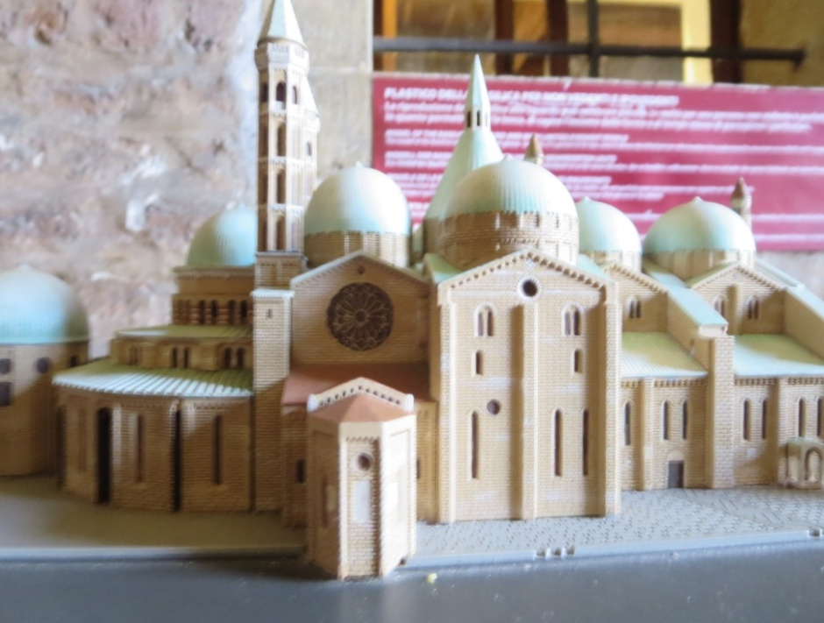
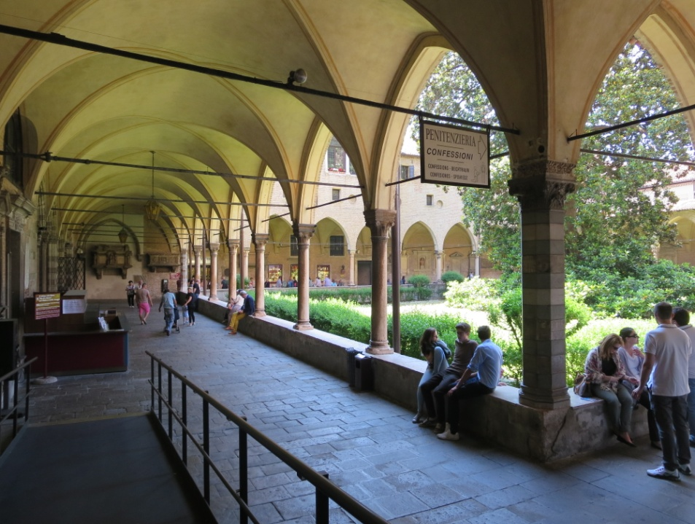
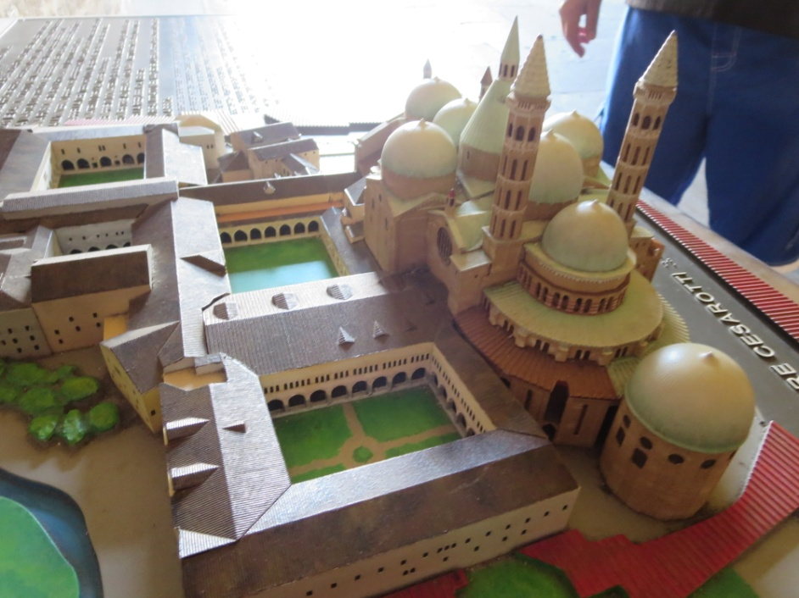
JT Wunderlich 2004, 2008, 2009, 2011, 2014 Professor

Slide 32
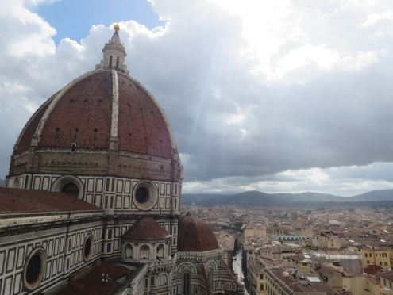
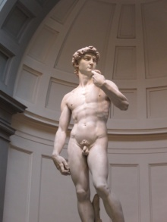
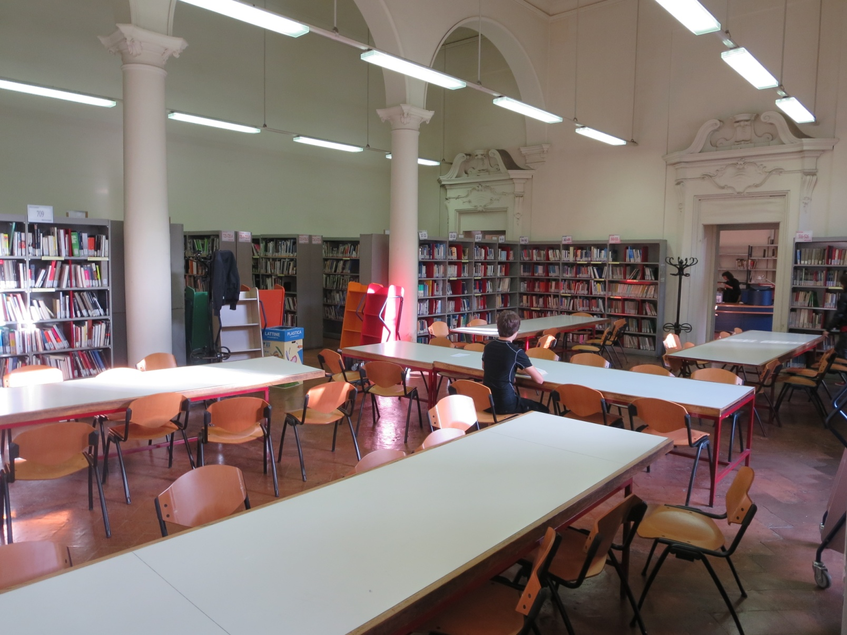
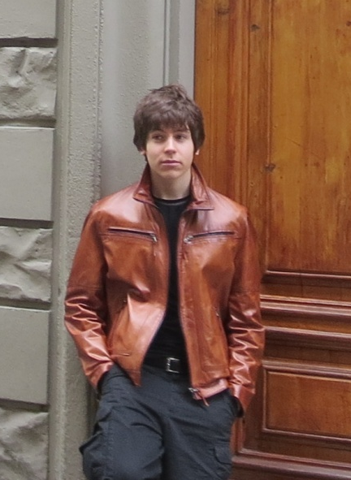
JT Wunderlich 2004, 2008, 2009, 2011, 2014 Professor
more
HERE

Slide 33
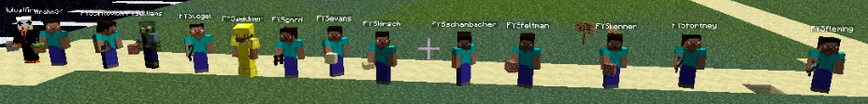
JT Wunderlich 2010-2013
Architectural Computer Servers
For college students and children worldwide
Crowdsourced Architecture and Urban Design
Servers configured & maintained on home machines and third-party hosting sites

Slide 34
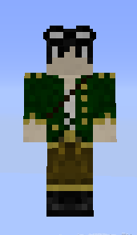
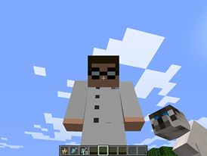
Multi-World “Tsojin”
JJW IV JTW III
Computer servers
PLAYER RANKING; Guest, Builder, Architect, Master, Admin, and Grandmaster -- each with accumulated commands.
SQL DATABASE SERVER for logging player activity to allow rolling-back of “griefing” (destruction or construction by un-invited or misbehaving players). Initial release of Tsojin was public; After griefing by organized griefing teams, Tsojin was made private
MULTI-WORLD plug-in to allow concurrent worlds (and teleportation & gateways between). Tsojin has six worlds.
Many other plug-ins (foul-language censorship, establishing monetary systems, allowing aircraft and vehicles to move, locking tool chests, sign-posting, etc.).

Slide 35
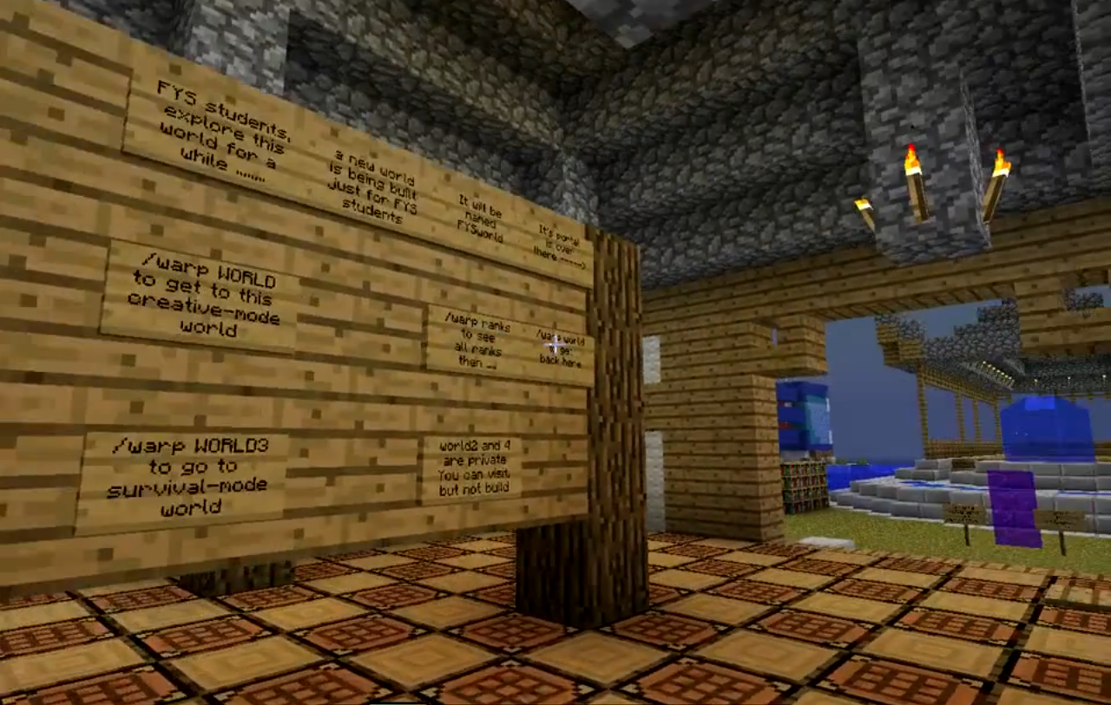
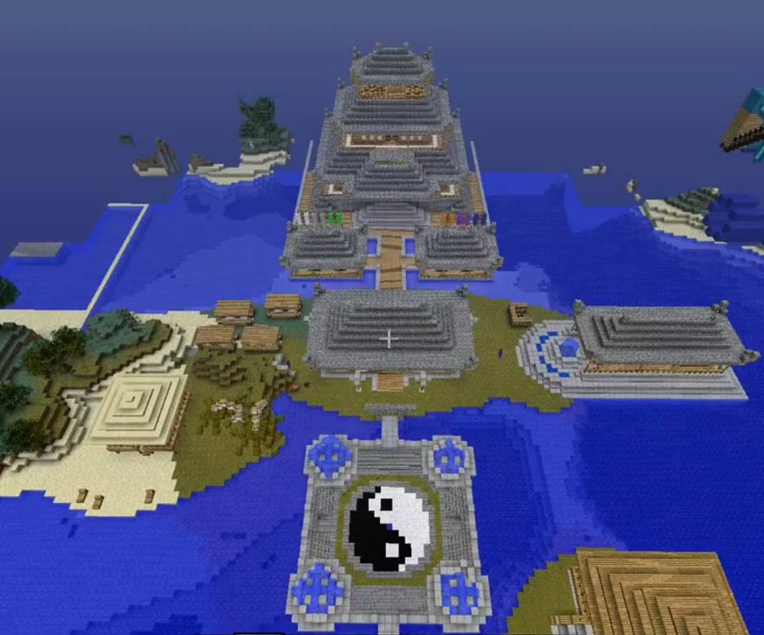
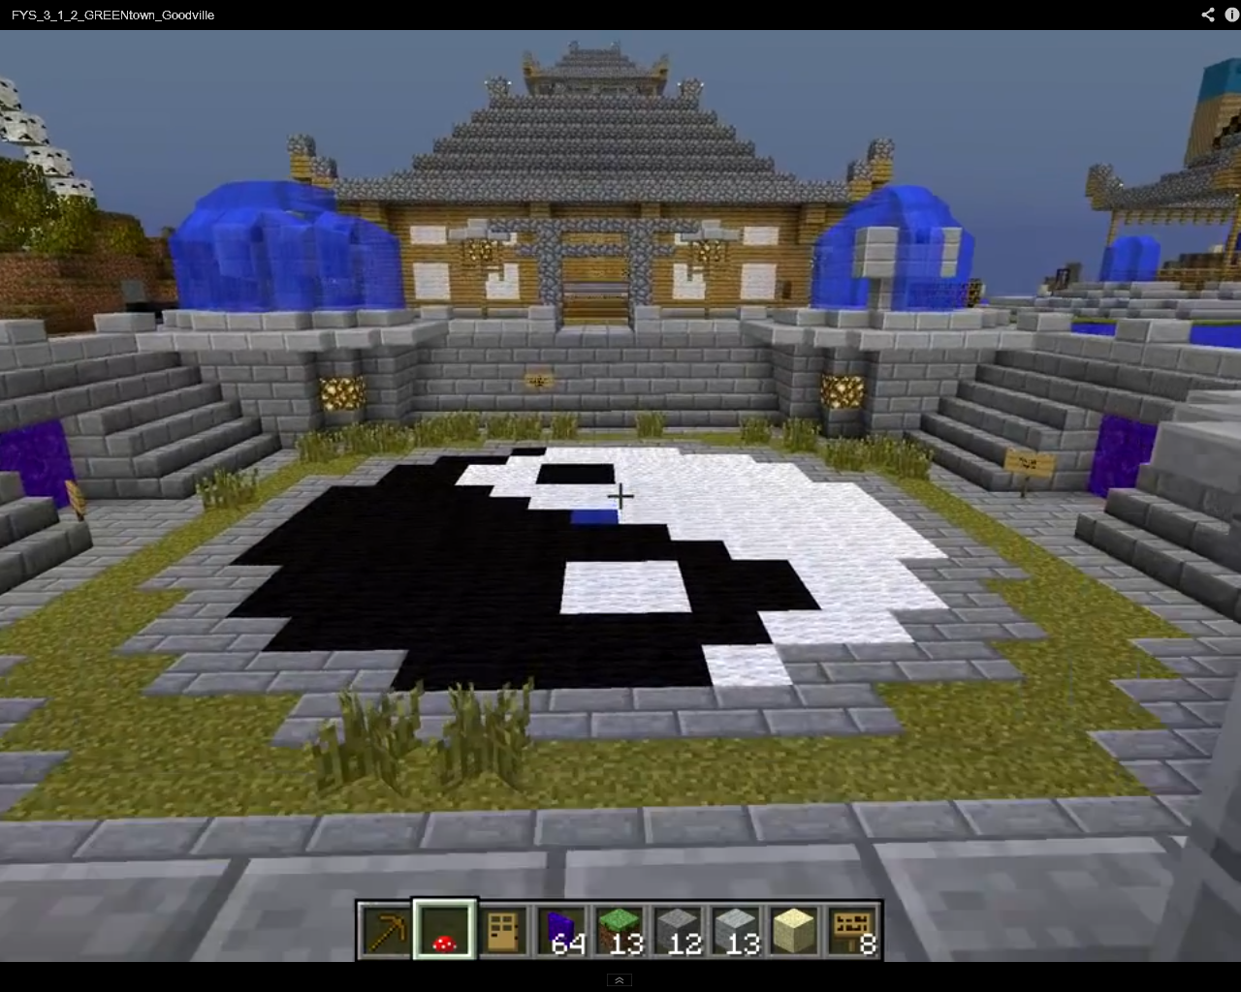
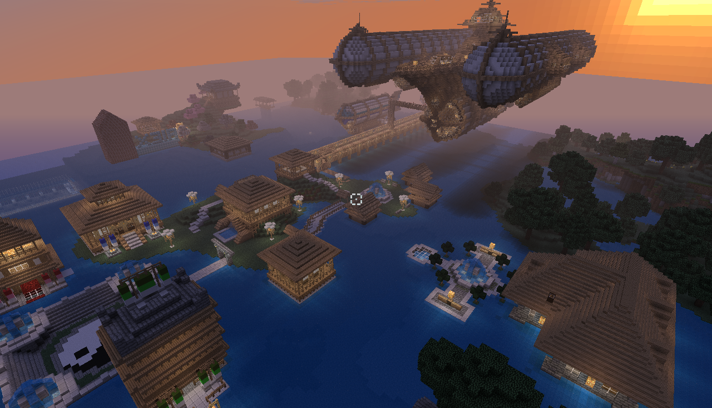

2010 All initial TSOJIN Architecture
by my son Joseph J Wunderlich (JJW IV)

Slide 36

by College students in Architecture, Engineering, Computer Science, Cognitive Science, and Philosophy
2012 Crowd-sourced VIDEO
College Campus Buildings

Slide 37

2012 Crowd-sourced
Four Sustainable towns
College Freshman from many Majors
Wellness centers built by visiting High School Students

Slide 38


2012 Crowd-sourced VIDEO
Sample Wellness Center
Case 9: Wellness Center Competition #1

Slide 39



JT Wunderlich 2013 Studied Japanese Architecture in Japan (while presenting and vacationing) Kyoto Osaka Narita

Slide 40



JT Wunderlich 2013 Surveyed Japanese Architecture in Japan (while presenting and vacationing) Kyoto Osaka Narita

Slide 41





more HERE

Slide 42

2013 Crowd-sourced
Four Japanese towns
College Freshman from many Majors
Wellness centers built by visiting High School Students

Slide 43
Website for many student and guest Architectures:
http://users.etown.edu/w/wunderjt/TSOJIN_ranks.pdf
YouTube videos for many student and guest Architectures:
https://www.youtube.com/channel/UC_kM_k93zreIu40CVwuHQzg?feature=watch

Slide 44


JT Wunderlich 2010-2014
Publications and talks given in Osaka Japan and London England:
http://users.etown.edu/w/wunderjt/Green_Social_Designs_Japan_paper_19.pdf
http://users.etown.edu/w/wunderjt/Green_Social_Designs_Japan_TALK_19_PLUS.pdf
http://users.etown.edu/w/wunderjt/CrowdSourced%20Architecture%20and%20Environmental%20Design_PAPER_15_TALK_SUBMITTED_EDITTED_Wunderlich.pdf
http://users.etown.edu/w/wunderjt/CrowdSourced Architecture and Environmental Design_PAPER_15_FINAL_SUBMITTED_EDITTED_Wunderlich.pdf

Slide 45

JT Wunderlich 2002-present (local case-study) Homeowner / Design-Builder
Southeastern Pennsylvania, USA

Slide 46


Before
After

Slide 47


Before After

Slide 48




THREE MAJOR DESIGN CHOICES

Slide 49

DESIGN CHOICE 1
HEAD-SPACE TOO CRAMPED

Slide 50


DESIGN CHOICE 2

Slide 51


DESIGN CHOICE 3

Slide 52


selected design
DESIGN CHOICE 3

Slide 53



Slide 54


Slide 55


Slide 56


Slide 57





Slide 58




Slide 59



Slide 60





Slide 61





Slide 62



Slide 63




FRAME VISTA’S

Slide 64



FRAME VISTA’S

Slide 65


FRAME VISTA’S

Slide 66



FRAME VISTA’S

Slide 67



Slide 68


Slide 69



Slide 70




Slide 71





Slide 72


Slide 73



(2012 LEED reflection)

Slide 74

JT Wunderlich 2002-present Homeowner / Design-Builder
Southeastern Pennsylvania
2000sf remodel +1500sf new
ARCHITECTURE THEORY (2015 reflection)
Form = cubes and gables, vertical
Scale = human
Behavior = home, animal reserve
Context = Amish and Mennonite farmland
Proportion = complimentary gables
Balance = asymmetrical
Symbolism = stability, family, framed vista’s
Tastes = traditional, simple elegance
Anthropomorphism = none intended
Color = white, grey, black
Texture = smooth, ordered
Rhythm = semi-syncopated
STYLE = Post-modern, colonial, craftsmen

Slide 75

ETOWN Architecture 2015
Revit Software
http://users.etown.edu/w/wunderjt/home_student_ARCHITECTURE_EGR343_2014.html

Slide 76
ETOWN Architecture 2015
Revit Software
http://users.etown.edu/w/wunderjt/home_student_ARCHITECTURE_EGR343_2014.html

Slide 77
ETOWN Architecture 2015
Revit Software
http://users.etown.edu/w/wunderjt/To_Stakeholders.pdf

Slide 78
EXTRA SLIDES ---------------→
(Likely not shown in talk)

Slide 79
JT Wunderlich PhD
Architecture Portfolio
B.S. Architectural Engineering 1984 (U. Texas, Austin)
M.Eng. Engineering Science 1992 (Penn State)
Ph.D. Electrical (& Computer) Engineering 1994 (U. Delaware)
Plus two years (39 credits) of Urban and Environmental Design (U. California, San Diego)
Over ten years of Architecture experience in Texas, California, and Pennsylvania
SEE FULL RESUME: http://users.etown.edu/w/wunderjt/Wunderlich,JoeCV.pdf

Slide 80
JT Wunderlich Architecture Portfolio
* = exhibited in this portfolio
* 1971-1975: 24 balsawood buildings, model railroading hobby
(displayed in private grade school and public junior high) ages 10-14
* 1977: 3rd Prize, Philadelphia Municipal Building
(state-wide architectural design competition) age 16
1980: 1st Prize, paper column & bridge contest, Penn State (column held 33 bricks, a University record)
1981: 2nd prize, Modular Lunar Buildings design, Penn State (US Steel sponsored competition)
* 1981: Arts Interest House Design, Ink-on-Mylar drawings (Penn State Architecture Design Studio III)
* 1981: Office Building Design & Engineering (Penn State Working Drawings course)
* 1981,82: Design/Builder, many small remodels, State College PA (two intermittent employees)
1982-84: Owner, Construction Estimating business, Austin TX
(negotiated contracts with contractors for computer-generated quantity estimates)
1984: BS Architectural Engineering, University of Texas at Austin
1984,85: Project-Manager/Designer, West Lake Oaks office complex, thirteen buildings
Doerring Development Corporation, Austin TX (Design/Build/Development company)
(worked under Registered Architect, two buildings had IBM/360 raised-floor computer rooms)
1985,86: Director of Projects/Designer, 100,000sf hi-tech “Cornerstone” office complex
JDC inc, La Jolla CA (Developer)
(Project nominated for San Diego “Orchid” award)
1986: Designer, Del Mar CA upper-story addition, ocean-view

Slide 81
JT Wunderlich Architecture Portfolio
* = exhibited in this portfolio
1986,87: 39 credits in Urban & Environmental Design, University of California San Diego (UCSD)
(2nd BS program) – 3 exhibits: Campus Design, La Jolla Development, City Design Theory paper
* 1986,87: Urban Planner, San Diego County Local Agency Formation Commission (3/4-time)
* 1987: Design/Builder, 1000sf Calivita House remodel, San Diego CA
* 1987,88: Architectural Engineer, Lead-Designer for San Francisco Bay Area
PSI inc, Lafayette CA, formerly Hall-Kimbell (Headquarters in Lawrence KS)
* 1989,90: Design/Builder, 1500sf School Lane remodel, Wayne PA
* 1990: Hobbyist, Scale model of brother’s house; Doll house for children
1991: Design/Builder, 1000sf Chen remodel, Ambler PA (including rec-room, bar, cabinetry)
2000: Member, planning committee for new $12M Elizabethtown College Student Center
* 2002-present: Design/Builder, 2000sf remodel + 1500sf new, Manheim PA (personal farmette)
* 2004: Wrote Spec’s for Design & Technology-Transfer Studio (formerly Robotics & Machine Intelligence Lab )
* 2004,2008,2009,2011,2014: Studied Italian Architecture while presenting and teaching in Italy
* 2010-13: Created Architectural computer servers for College students, and guests world-wide
* 2011-13: Created (and teach courses in) Elizabethtown College
Sustainable Design Engineering Major, and Architectural Studies Minor
2013: Studied Japanese Architecture while traveling and presenting in Japan
2014,15 Member of Sustainability Committee , Elizabethtown College PA
2014,15 Primary Investigator for Elizabethtown College Social Enterprise projects:
Trucker Wellness Center Designs, Sierra Leone Africa Health Clinic Designs

Slide 82

Download PowerPoint of full portfolio:
http://users.etown.edu/w/wunderjt/Wunderlich_JT_Architecture_and_Urban_Design_PORTFOLIO.pptx
JT Wunderlich 2015 Professor

