Slide 1
Mobile Wellness Center Design Competition
J. Wunderlich, PhD
Director of the Design and Technology-Transfer Studio
Engineering. Computing, and Architectural Programs
Elizabethtown College

Slide 2
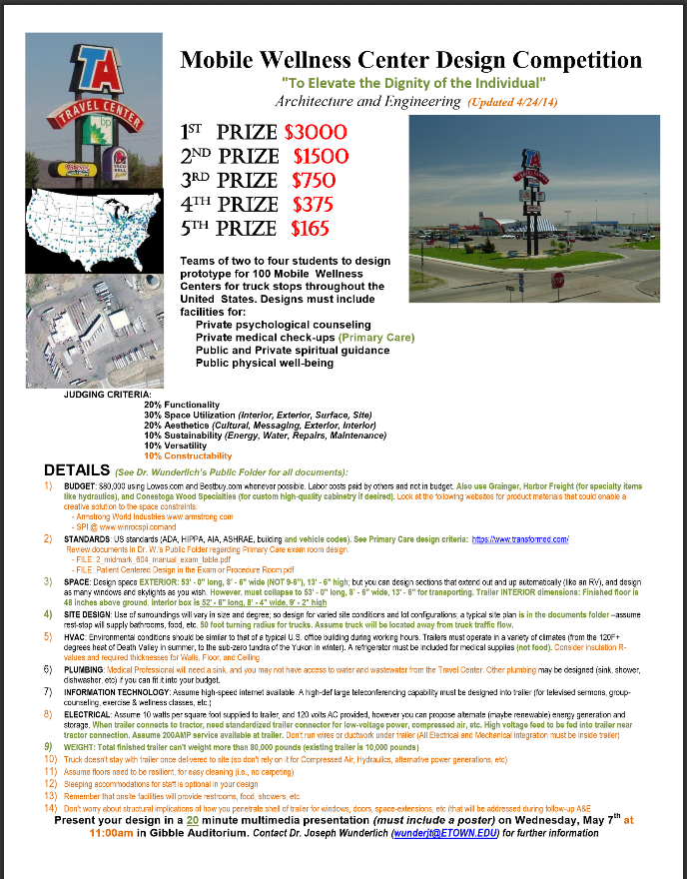
Flyer (LINK)

Slide 3
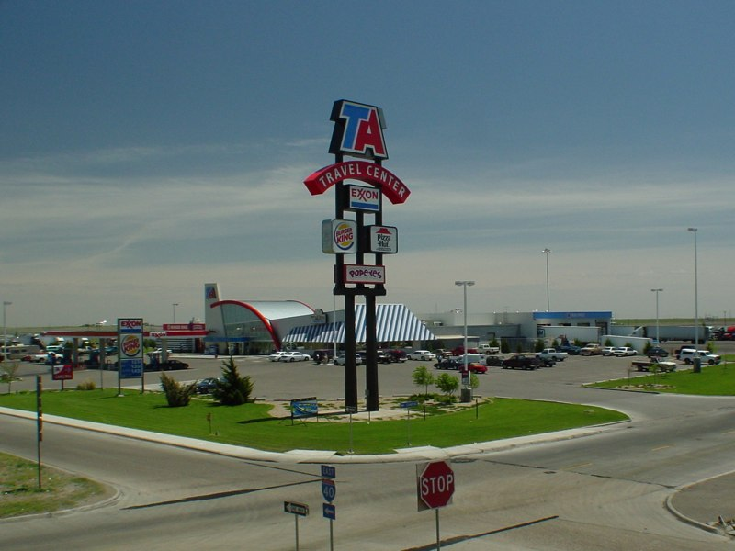
Mobile Wellness Center Design Competition

Slide 4
Mobile Wellness Center Design Competition
To Elevate the Dignity of the Individual

Slide 5
Mobile Wellness Center Design Competition

Slide 6
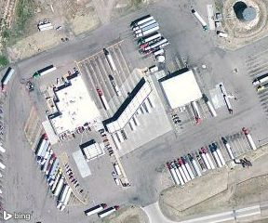
Mobile Wellness Center Design Competition

Slide 7
Mobile Wellness Center Design Competition
Five teams created conceptual designs including:
  Spiritual guidance
  Psychological counseling
  Medical check-ups
  Physical well-being
    (Somewhat optional)

Slide 8
Mobile Wellness Center Design Competition
1ST PRIZE $3000
2ND PRIZE $1500
3rd PRIZE $750
4th PRIZE $375
5th PRIZE $180

Slide 9
Mobile Wellness Center Design Competition
JUDGING CRITERIA:
  Functionality
  Space Utilization (Interior, Exterior, Surface, Site)
  Aesthetics (Cultural, Messaging, Exterior, Interior)
  Sustainability (Energy, Water, Repairs, Maintenance)
  Versatility
  Constructability

Slide 10
Mobile Wellness Center Design Competition
BUDGET:
$80,000
Using Lowes.com , Bestbuy.com, Grainger, Harbor Freight (for specialty items like hydraulics), and Conestoga Wood Specialties (for custom high-quality cabinetry if desired)
Labor costs paid by others and not in budget.

Slide 11
Mobile Wellness Center Design Competition
STANDARDS:
US : ADA, HIPPA, AIA, ASHRAE, building and vehicle codes
Primary Care Medical design criteria: https://www.transformed.com/

Slide 12

Mobile Wellness Center Design Competition
SPACE:
Finished floor is 48 inches above ground
EXTERIOR: 53' - 0" long, 8’ - 6" wide , 13' - 6" high
INTERIOR: 52' - 6" long, 8’ - 4" wide, 9' - 2" high
Can design sections that extend out and up
Websites for creative solutions to the space constraints:
- Armstrong World Industries www.armstrong.com
- SPI @ www.winrocspi.comand

Slide 13
Mobile Wellness Center Design Competition
SITE DESIGN:
Use of surroundings will vary in size and degree
Design for varied site conditions and lot configurations
Assume rest-stop will supply bathrooms and food
50 foot turning radius for trucks
Assume truck located away from truck traffic flow

Slide 14

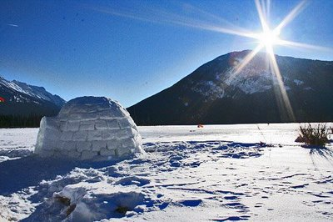
Mobile Wellness Center Design Competition
HVAC:
Must operate in a variety of climates (from 120F+ degrees of Death Valley, to sub-zero tundra of the Yukon)
A refrigerator must be included for medical supplies (not food)
Consider insulation R-values and required thicknesses for Walls, Floor, and Ceiling

Slide 15
Mobile Wellness Center Design Competition
PLUMBING:
Medical Professional will need a sink
May possibly not have access to water and wastewater from the Travel Center

Slide 16
Mobile Wellness Center Design Competition
INFORMATION TECHNOLOGY:
Assume high-speed internet available.
A high-def large teleconferencing capability must be designed into trailer (for televised sermons, group-counseling, exercise & wellness classes, etc.)

Slide 17
Mobile Wellness Center Design Competition
ELECTRICAL:
Assume 10 watts per square foot supplied to trailer
Can propose alternate (maybe renewable) energy generation and storage.

Slide 18
Concert Stage Design
A related talk just before presentations by mobile Wellness Center Contestants
By Anthony M. Bird
birda@etown.edu

Slide 19
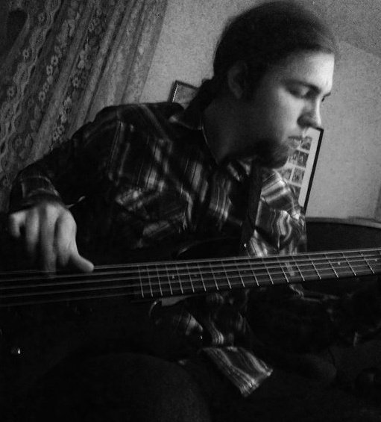
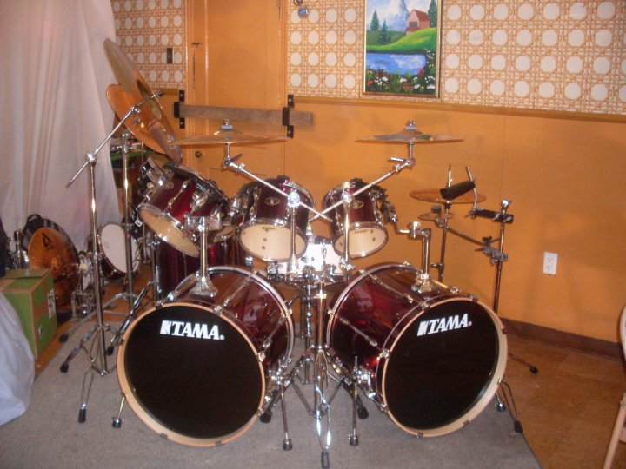
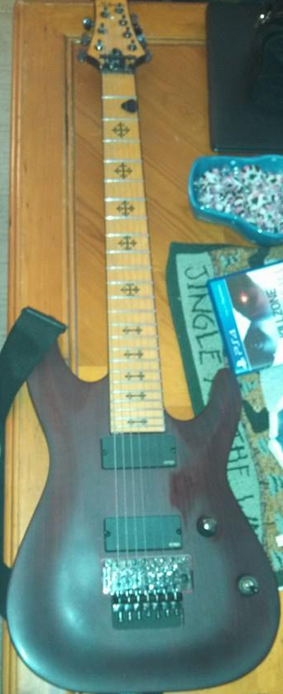
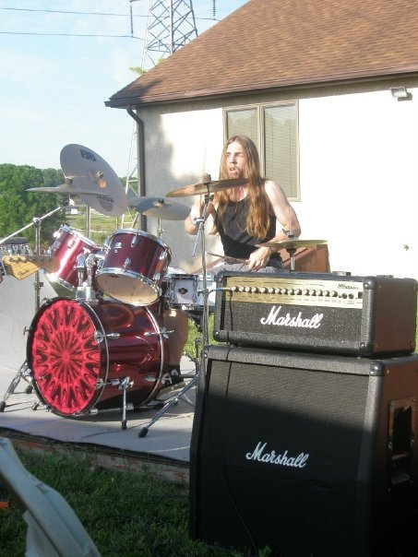
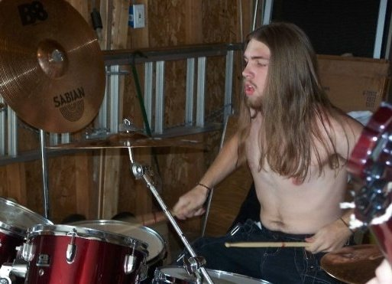
The Combination of Two Passions

Slide 20
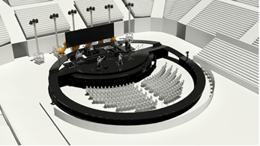
Staging
Temporary platform
Tait Towers: One of the biggest names in stage production 10 MILES FROM ETOWN – in LITITZ

Slide 21
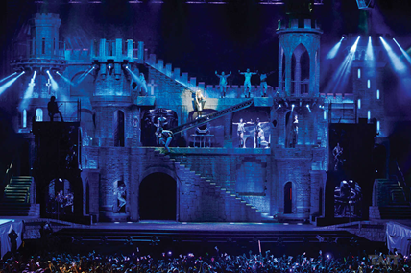
Staging
Physical staging
Lighting
Sound
Control system

Slide 22
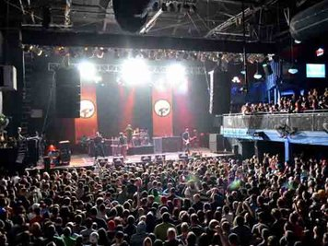
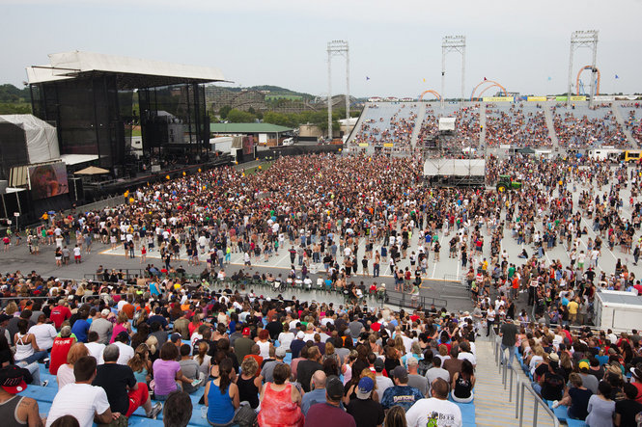
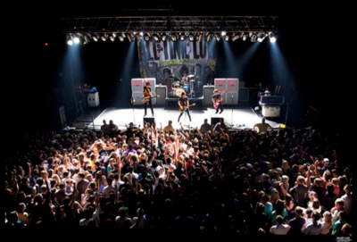
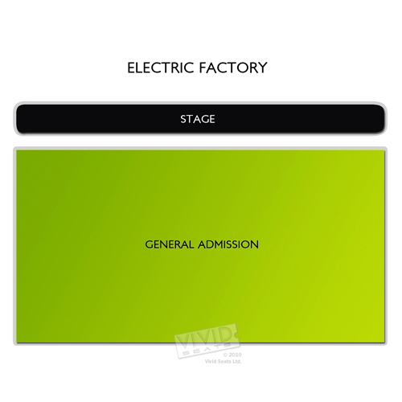
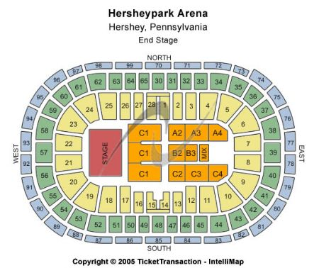
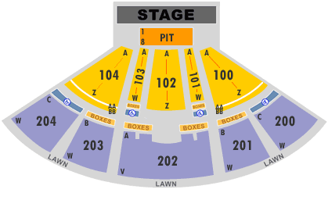
Electric Factory
- Indoor
-Capacity: 3,000
Starland Ballroom
- Indoor
- Capacity: EXPANDABLE
Hershey Arena
- Outside arena
- Capacity: 7,200

Slide 23
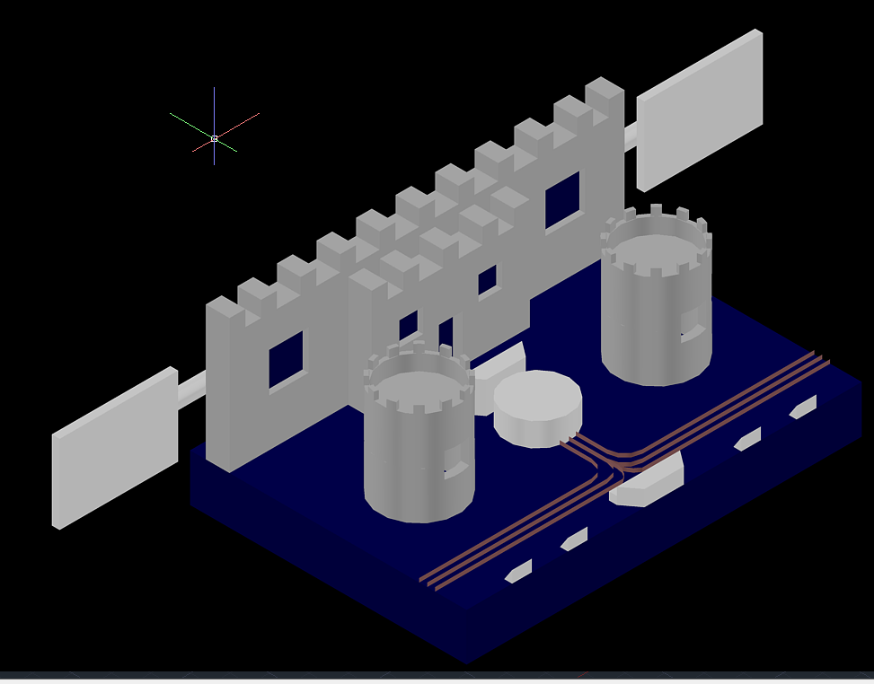
The Final Design

Slide 24
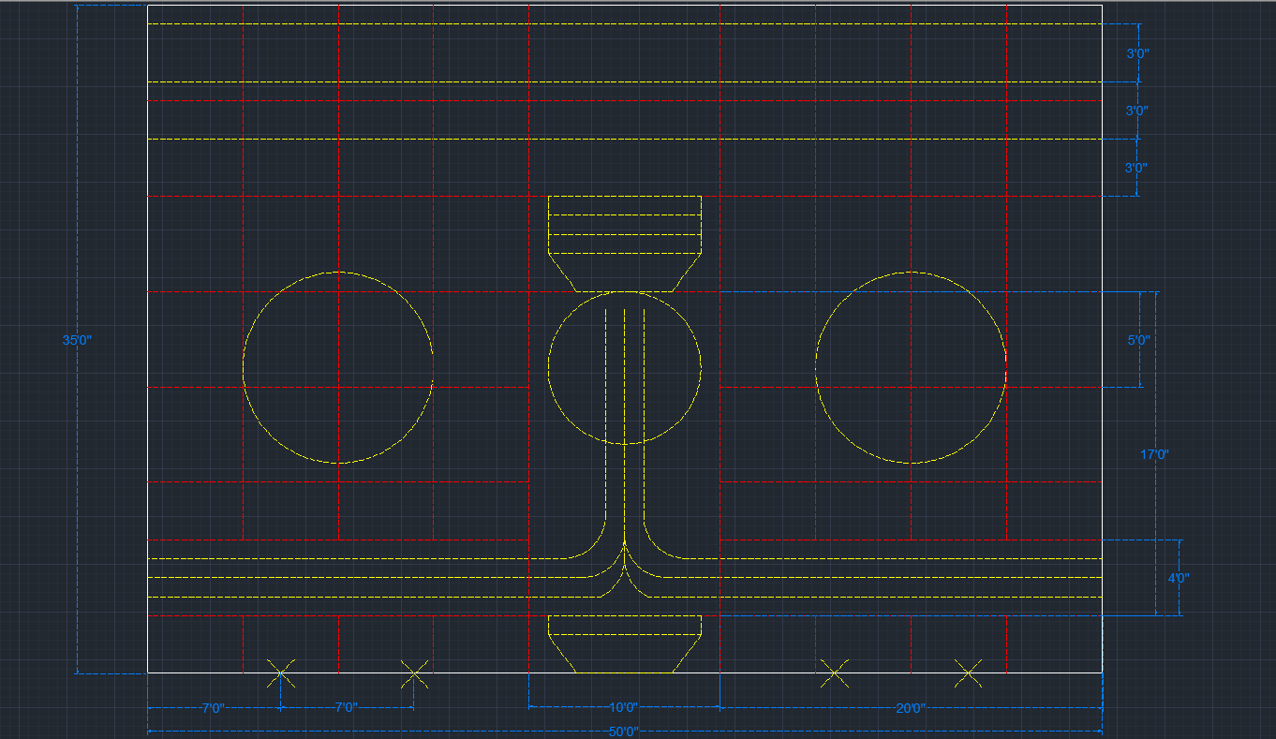
Stage Dissection
Modular Tower Design for easier transport and setup
Non-interactive backdrop
Screens
Speaker placement inside towers

Slide 25
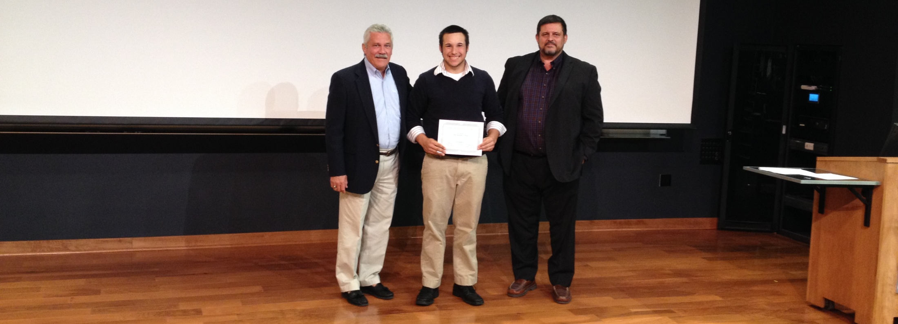
Mobile Wellness Center Design Competition
5th PRIZE $180

Slide 26
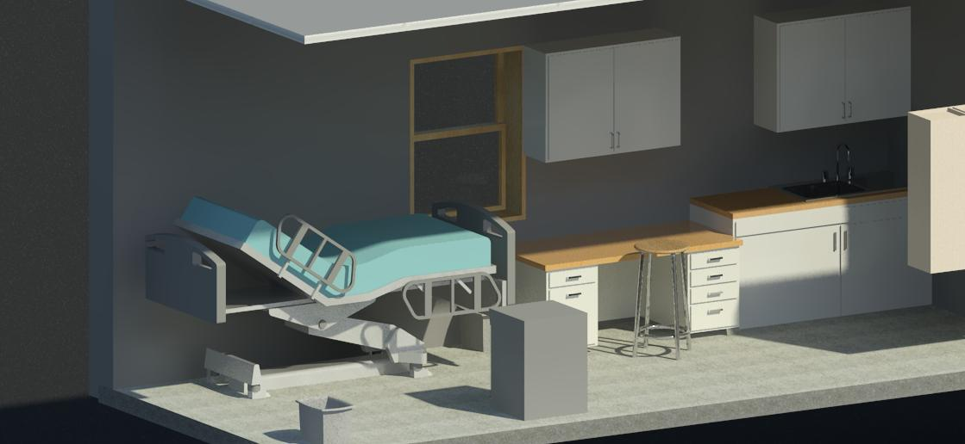
Mobile Wellness Center Design Competition
5th PRIZE $180
Student interviewed 150 truckers !

Slide 27
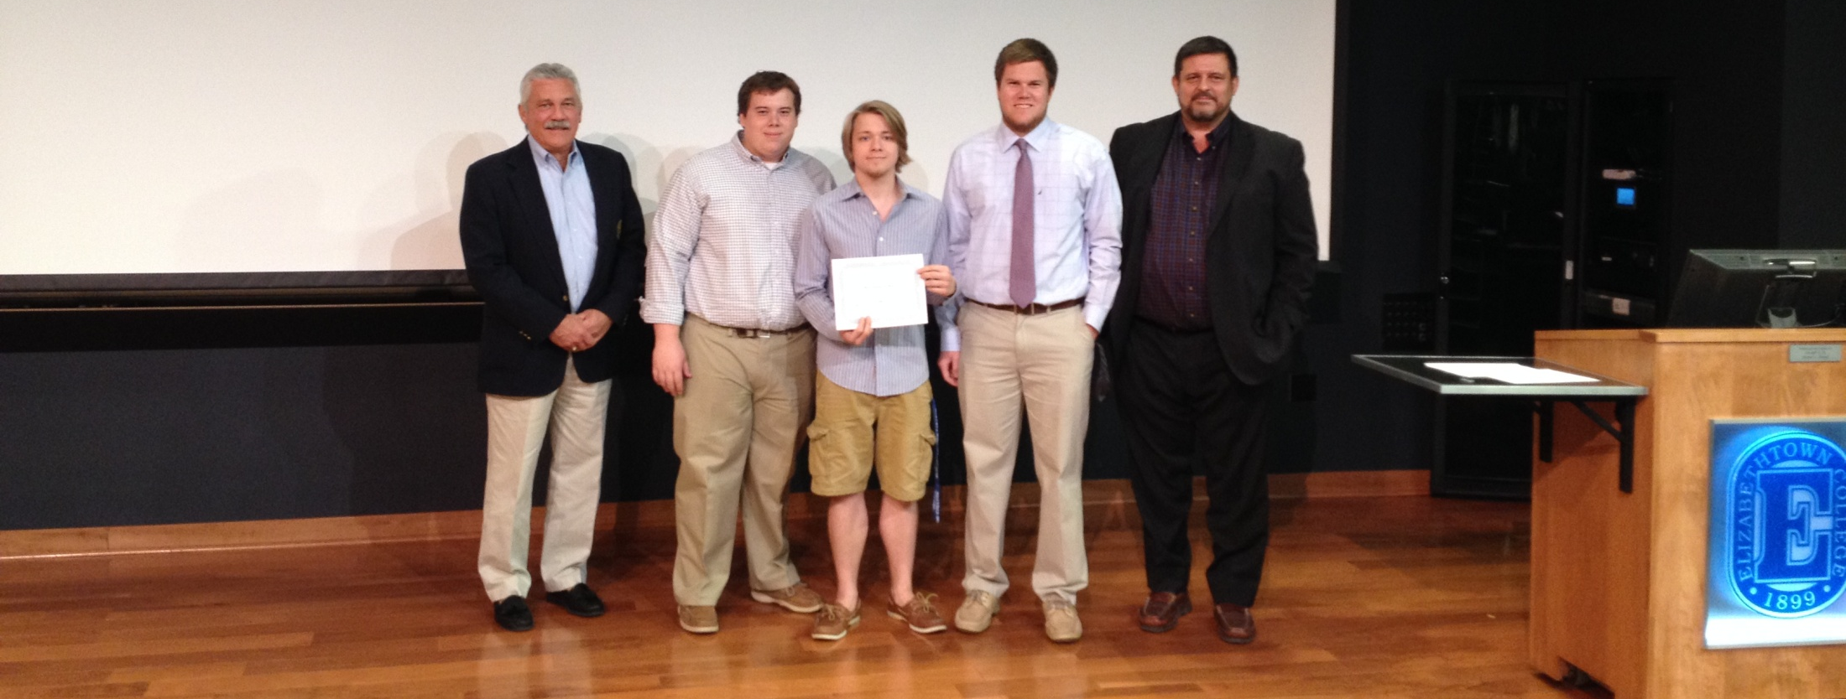
Mobile Wellness Center Design Competition
4th PRIZE $375

Slide 28
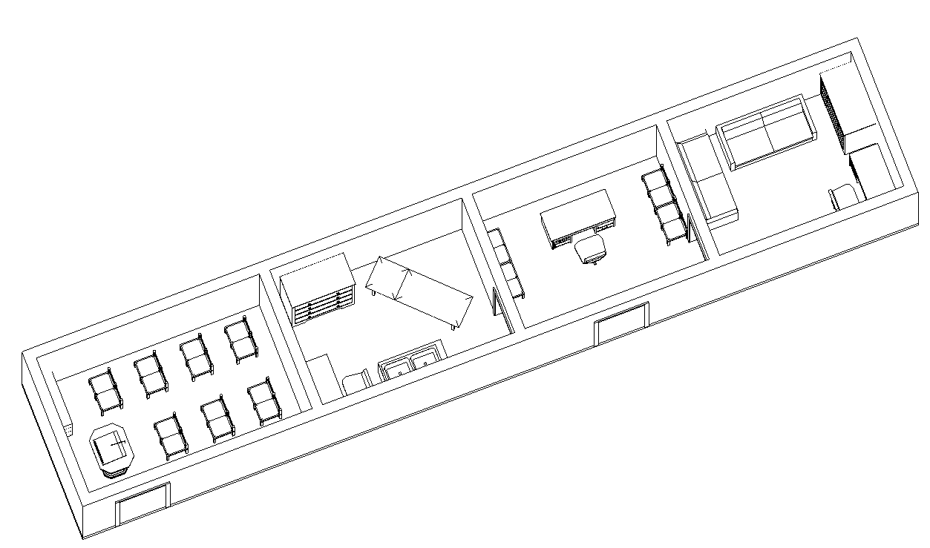
Mobile Wellness Center Design Competition
4th PRIZE $375

Slide 29
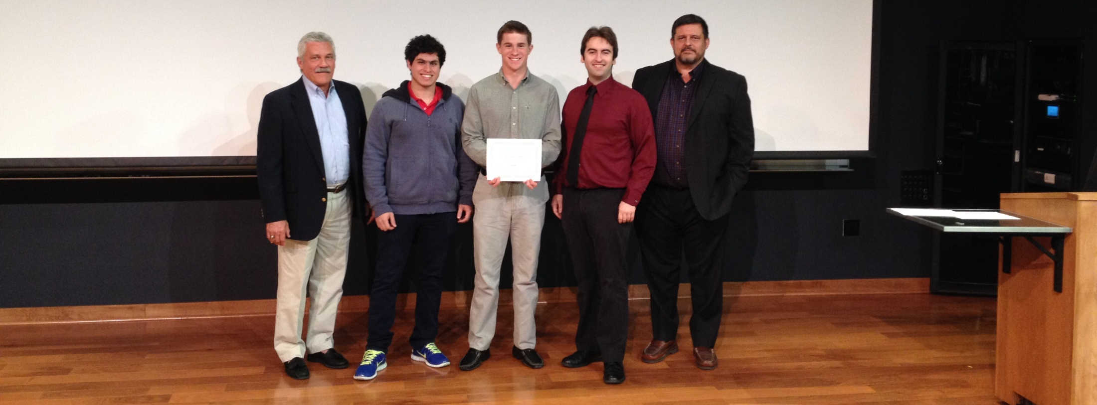
Mobile Wellness Center Design Competition
3rd PRIZE $750

Slide 30
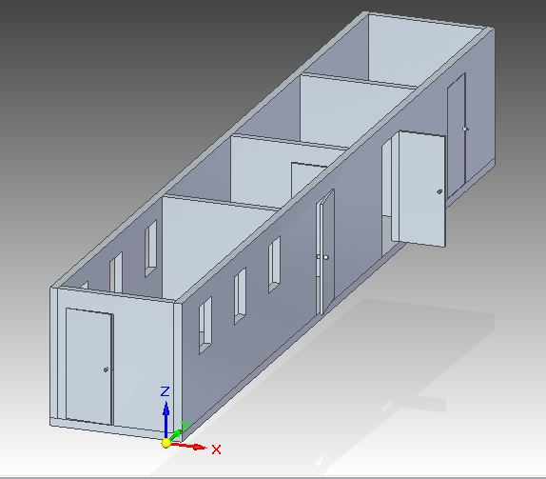
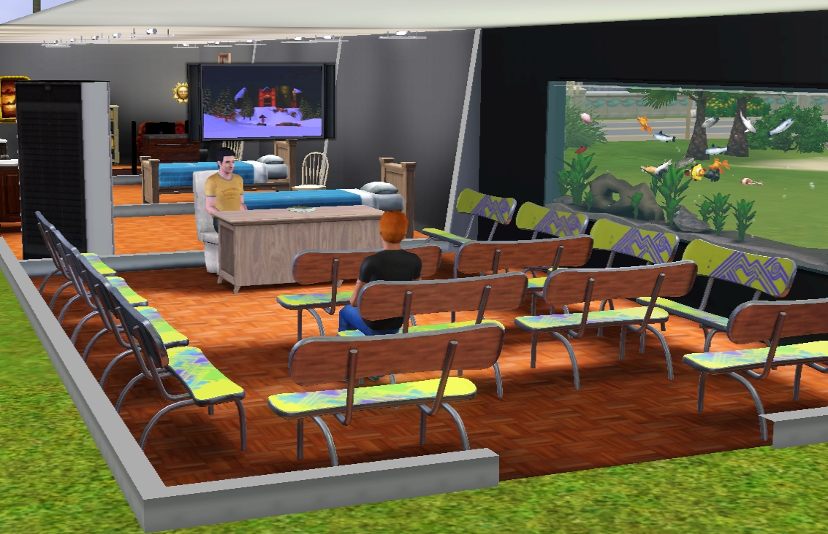
Mobile Wellness Center Design Competition
3rd PRIZE $750

Slide 31
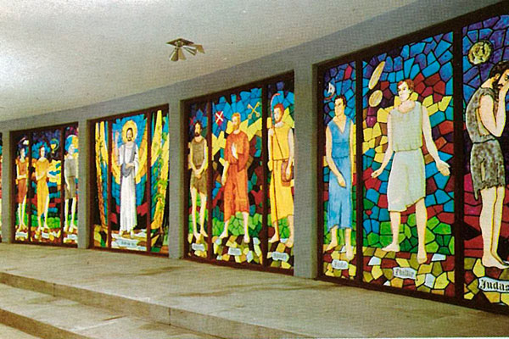
Mobile Wellness Center Design Competition
3rd PRIZE $750

Slide 32
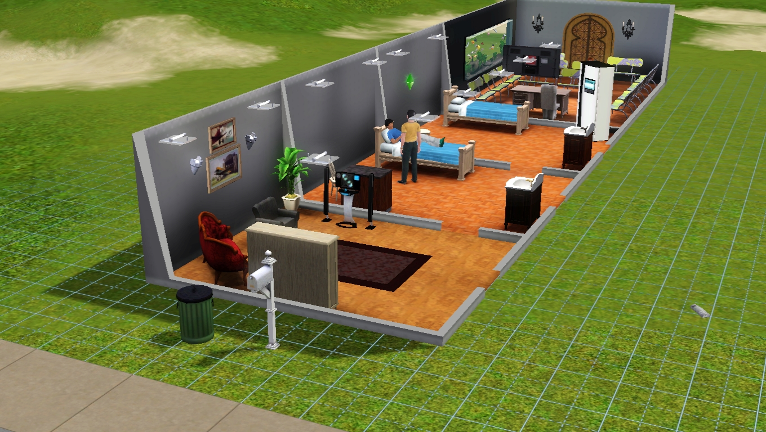
Mobile Wellness Center Design Competition
3rd PRIZE $750

Slide 33
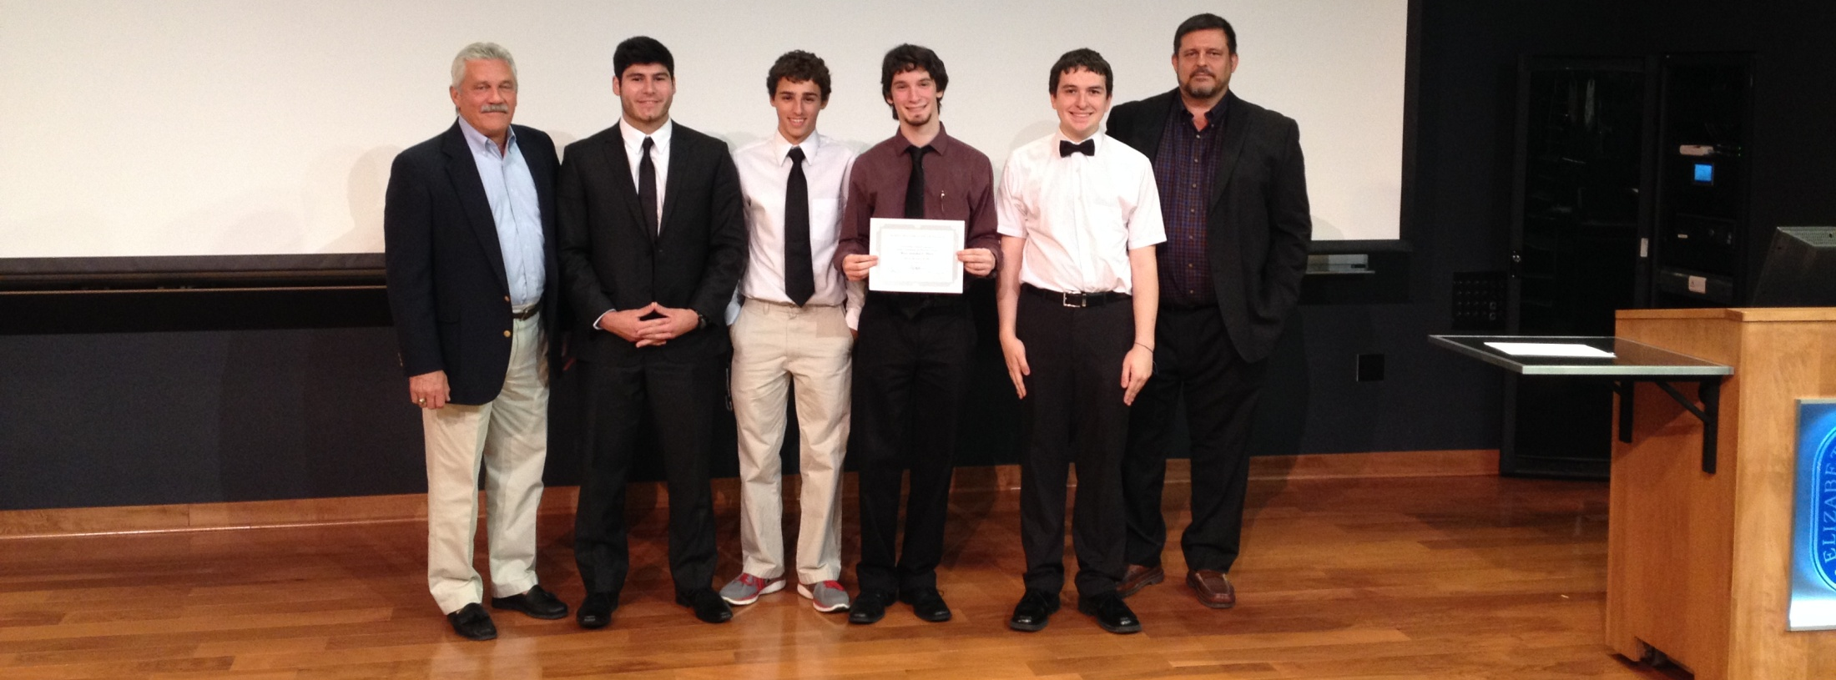
Mobile Wellness Center Design Competition
2ND PRIZE $1500

Slide 34
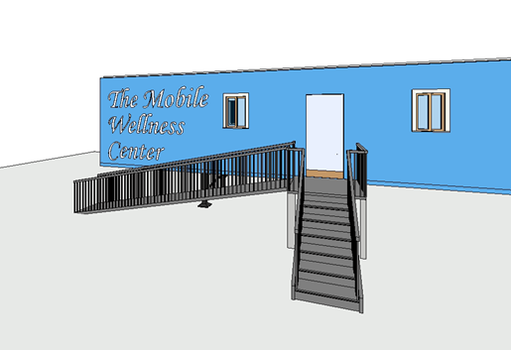
Mobile Wellness Center Design Competition
2ND PRIZE $1500

Slide 35
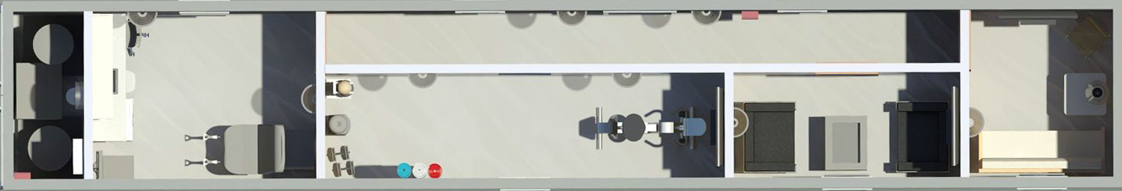
Mobile Wellness Center Design Competition
2ND PRIZE $1500

Slide 36
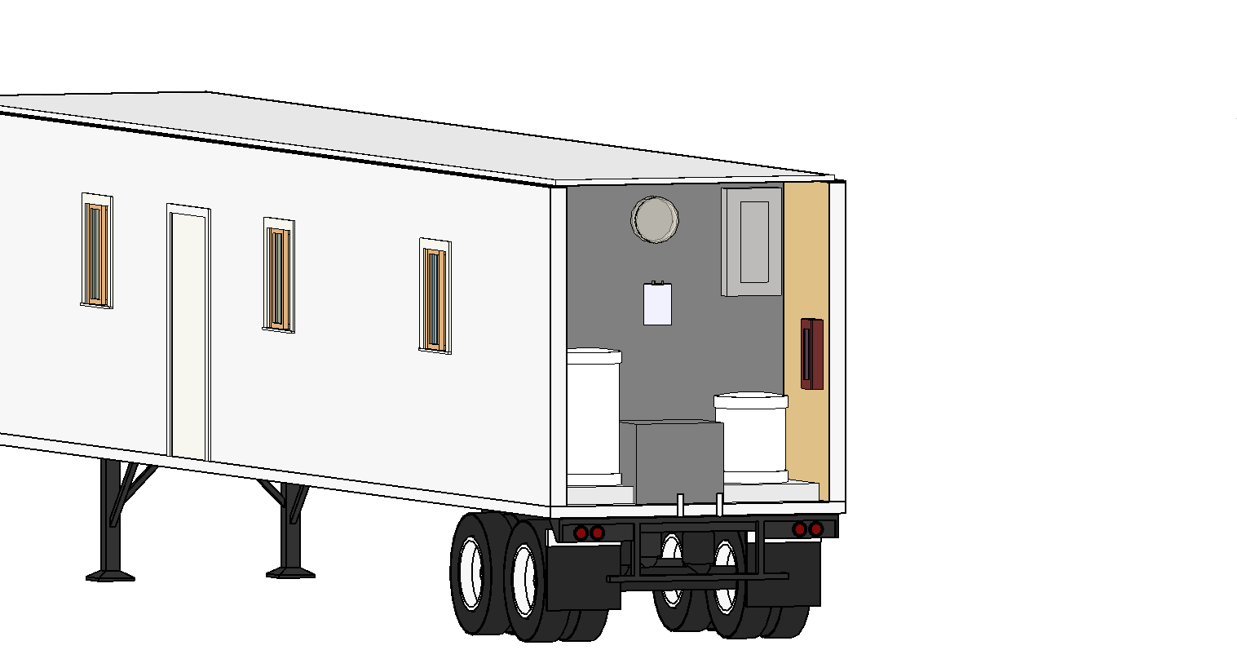
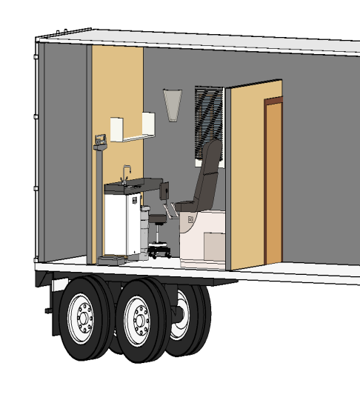
Mobile Wellness Center Design Competition
2ND PRIZE $1500

Slide 37
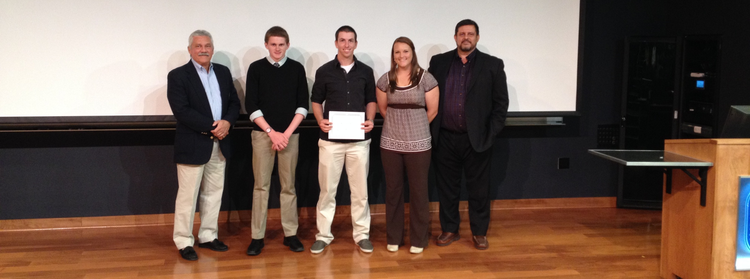
Mobile Wellness Center Design Competition
1ST PRIZE $3000

Slide 38
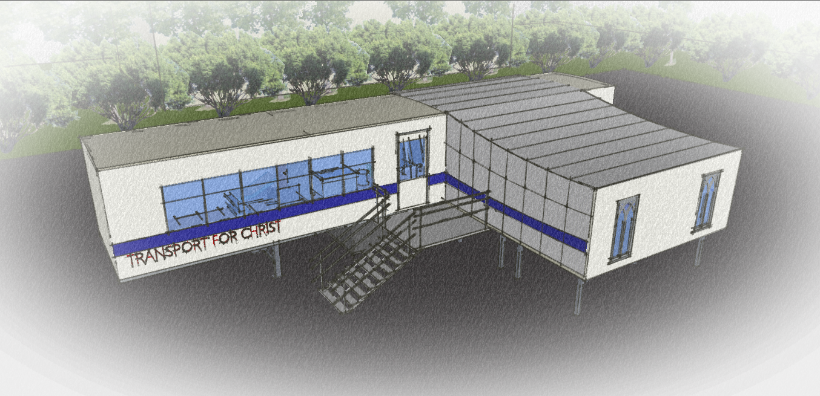
Mobile Wellness Center Design Competition
1ST PRIZE $3000

Slide 39
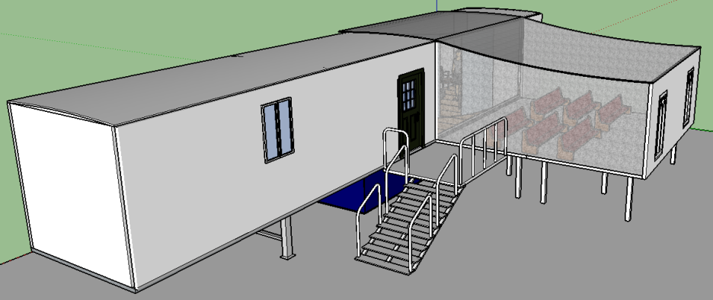
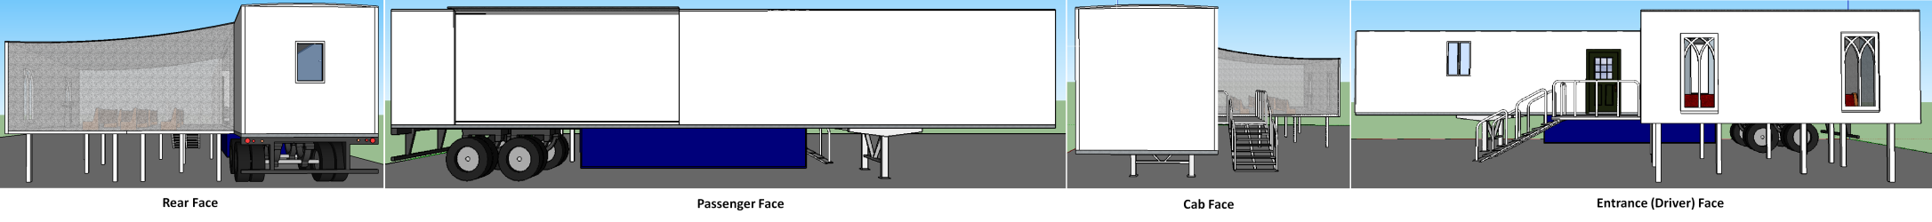
Original Design
Exterior
Movable trailer walls that will unfold into a raised floor for the chapel space.
What looks like a transparent sheet over the chapel area will actually be a fabric membrane that is insulated and will attached to the solid structure.

Slide 40
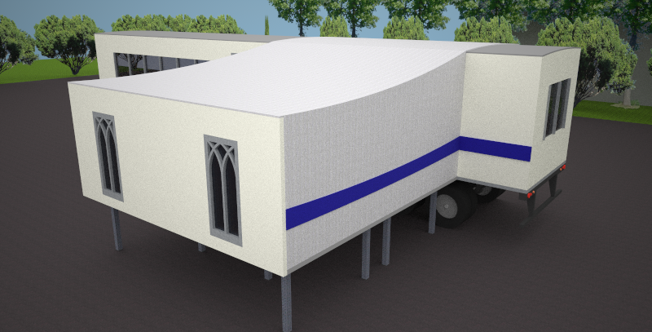
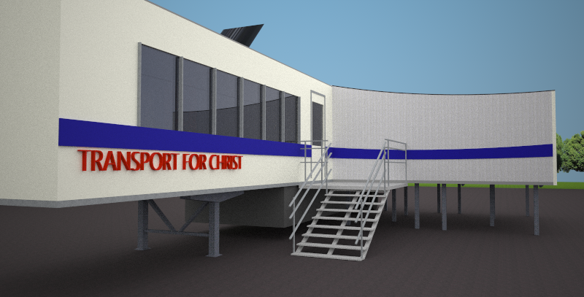
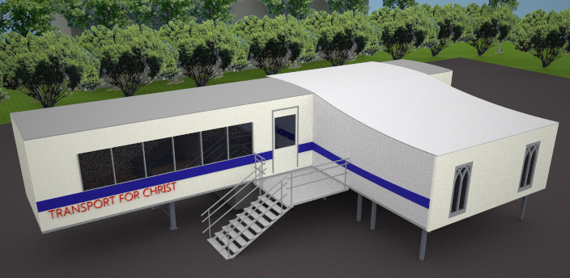
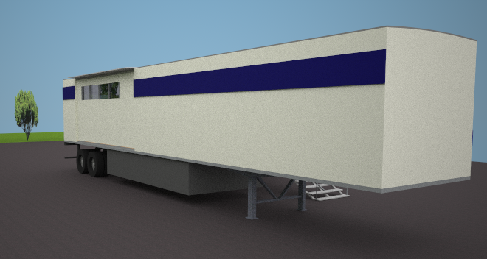
Newest Design

Slide 41
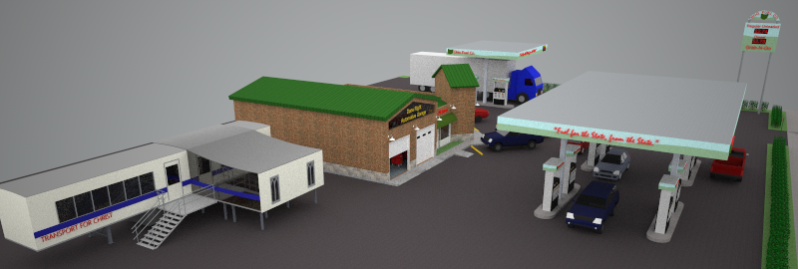
Example
The Mobile Wellness Center will be placed in an area that will be easily accessible to all the drivers, as seen below.

Slide 42
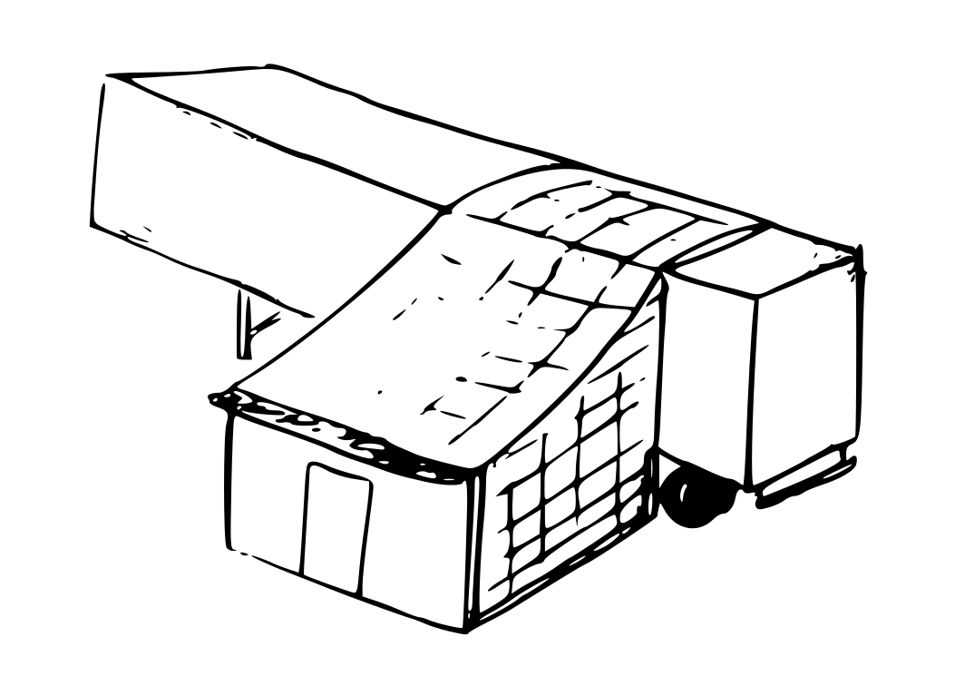
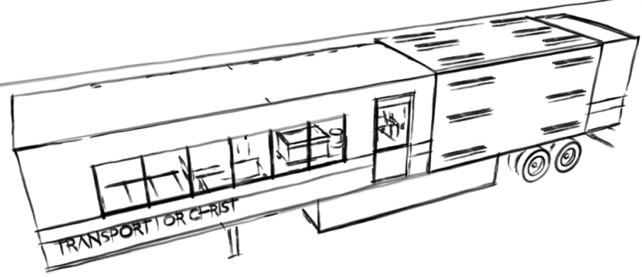
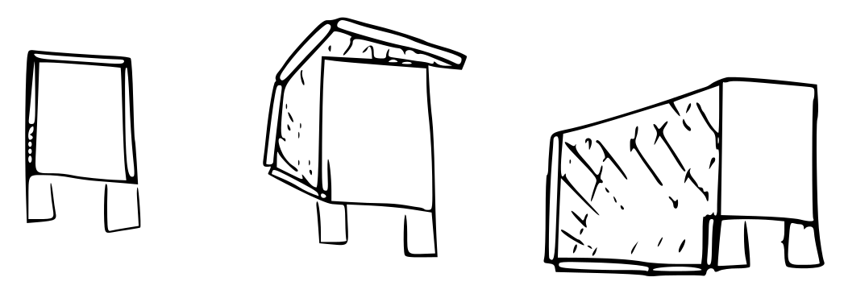
Folding Properties

Slide 43
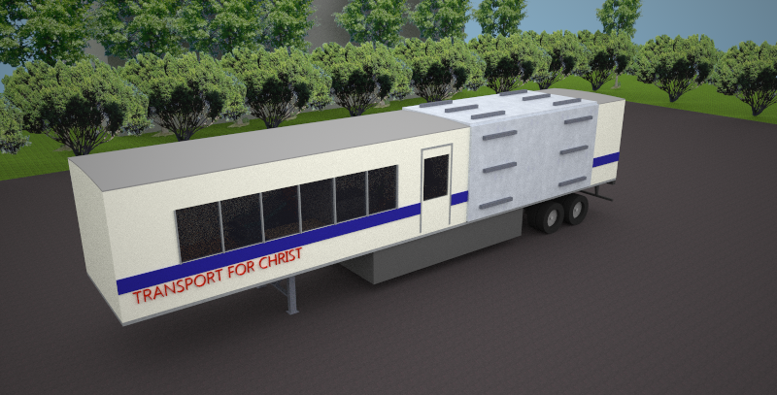

Slide 45
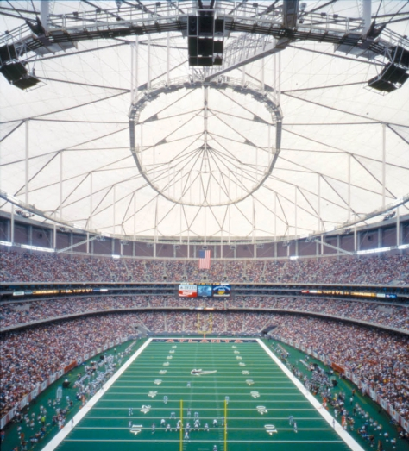
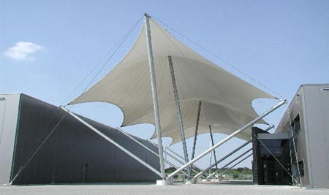
Design
Roof and Walls of Chapel
Light-weight fabric membrane with insulation properties for easy set-up and tare-down, and also functional for detachable shelter.

Slide 46
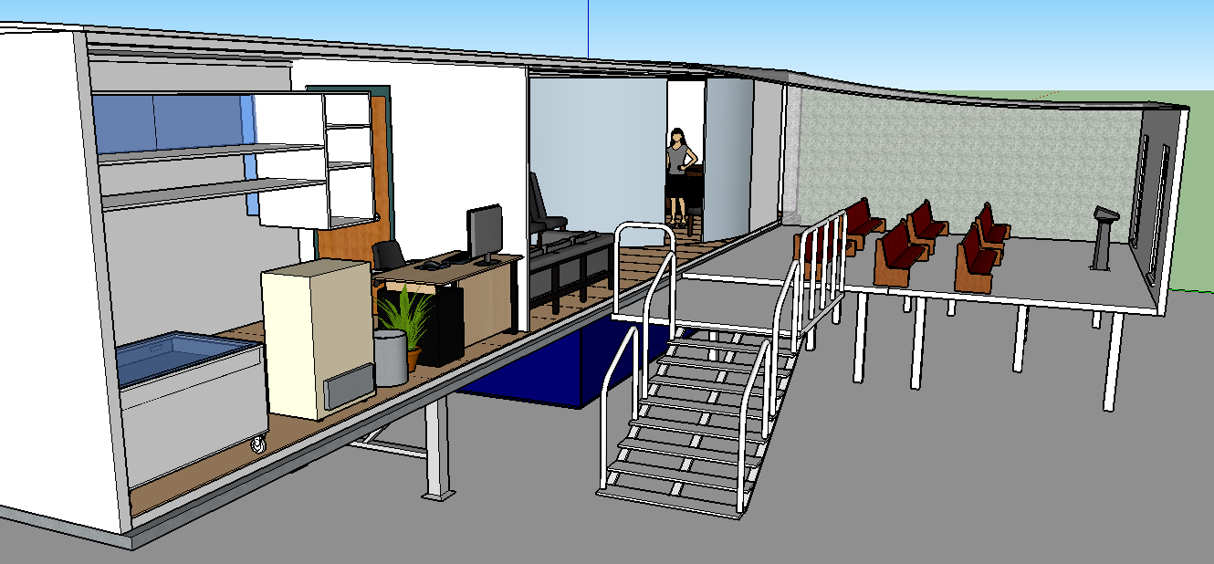
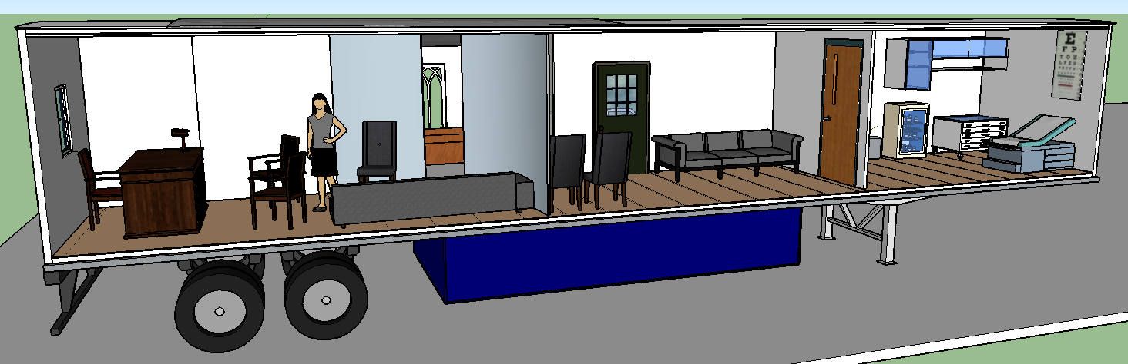
Design
Interior
Mobile
Chapel/Doctors office/Psychological Counseling

Slide 47

Design
Space utilization
Physical Health
Mental Health
Spiritual Health

Slide 48







Physical Health
Water-saving sink and Biohazards disposal containers for working with patients and medicines. The water tank will be place on the cab face of the trailer. This is an attempt to be eco-friendly and medically safe.
Notes:
This is the medical check-up room on the far right in the view directly to the right. The idea is to provide a means of obtaining basic medical treatment that truck drivers never have the time to get, due to being on such a strict schedule on the road. “Bring the doctors office to the driver.”

Slide 49


Slide 50
Mental Health
Psychological Counseling room/Chaplin’s office
Main Lounge/Waiting room
Notes:
We wanted to provide a space that drivers could come in and sit down and talk out any mental stresses with a professional or even with other drivers. The main room is located at the rear of the trailer, but there is also some seating accessible right inside the main door in the center of the trailer.

Slide 51

Spiritual Health
A nondenominational sacred space for the truck drivers
Notes:
By providing a nondenominational sacred space for the truck drivers we hope to uplift their spirits and help strengthen their connections with their deity. Transport for Christ has a Mobile Chapel that they put into effect recently and we were inspired by their efforts. The mental health area will also be utilized as a Chaplin’s office in order to provide religious confession or counseling when needed. It was important to make this sacred space multi-functional because there are many different beliefs associated with many different drivers.

Slide 52


Slide 53
ETOWN COLLEGE Wellness Center Design Competition
2014/15
J. Wunderlich, PhD
Director of the Design and Technology-Transfer Studio
Engineering. Computing, and Architectural Programs
Elizabethtown College

Slide 54


MANY years of related projects in our design studio

Slide 55




Wunderlich, J.T. and Wunderlich, J.J. (2013). Green architecture and environmental design using rapid-prototyping social-networking sandbox tools, followed by professional architectural software. Asian Conference on Sustainability, Energy & the Environment (ACSEE 2013), June 6-9, Osaka, Japan. TALK PAPER
Wunderlich, J.T. and Wunderlich, J.J. (2014). Crowdsourced Architecture and Environmental Design. 2nd International Conference on Emerging Trends in Engineering and Technology (ICETET'2014) May 30-31, London, England. TALK PAPER

Slide 56


Wunderlich, J.T. and Wunderlich, J.J. (2013). Green architecture and environmental design using rapid-prototyping social-networking sandbox tools, followed by professional architectural software. Asian Conference on Sustainability, Energy & the Environment (ACSEE 2013), June 6-9, Osaka, Japan. TALK PAPER
Wunderlich, J.T. and Wunderlich, J.J. (2014). Crowdsourced Architecture and Environmental Design. 2nd International Conference on Emerging Trends in Engineering and Technology (ICETET'2014) May 30-31, London, England. TALK PAPER

Slide 57

Wellness Center Design competition
MANY years of related projects in our design studio
2014/15

Slide 58
  Etown College Wellness Center Design Competition
  Green Architectural Engineering (EGR343)
  Conceptual Architecture (FYS100)
  Architectural Design Studio I & II (EGR/ART499 A&B)
2014/15

